Slide 1
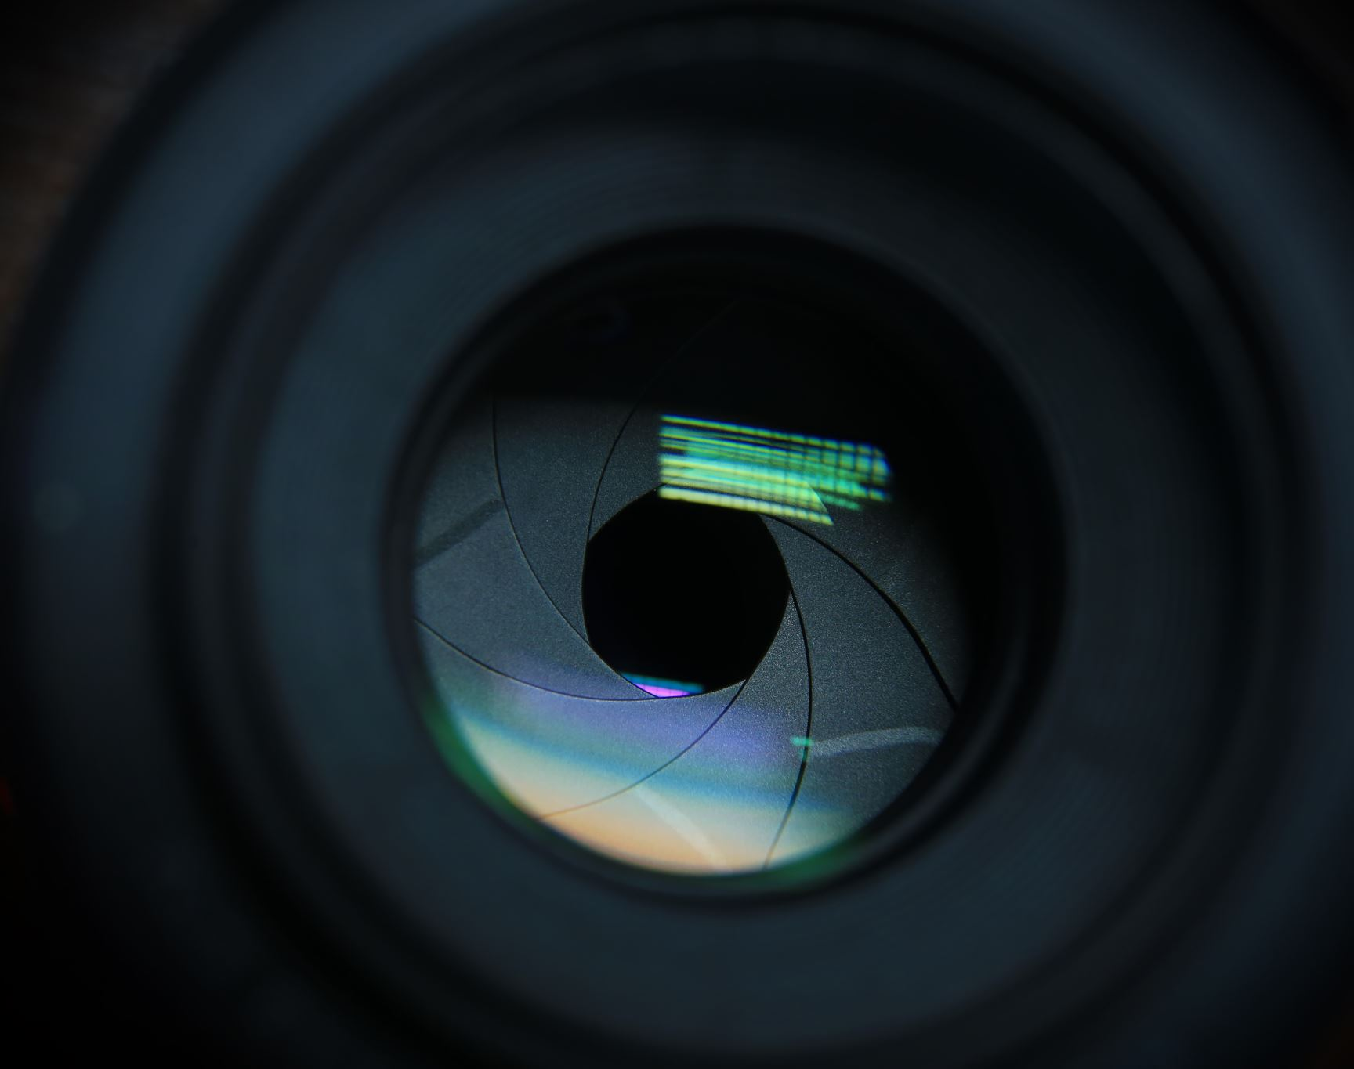
Image Classification with Coded Aperture
Overview, experiment results, and more

Slide 2

Experiments
Classify original MNIST images
1
Classify encoded MNIST images
2
Reconstruct encoded MNIST images, then classify from reconstructions
3
CNN with Sigmoid activation
CNN with NO activation

Slide 3
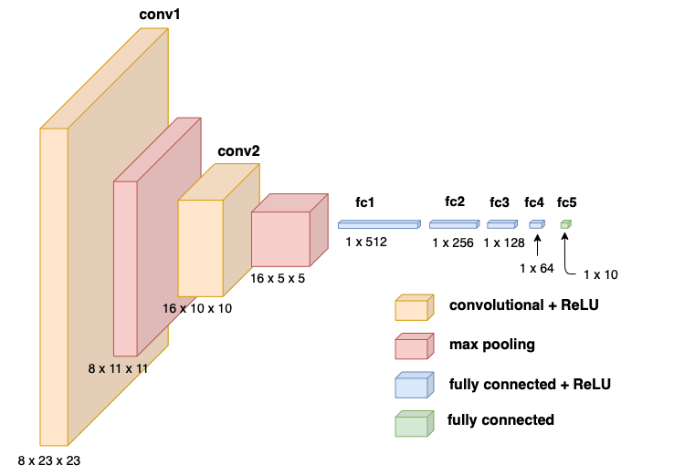
Classification Architecture
2 convolutional layers
2 max pooling layers
4 fully connected layers with ReLu activation
1 output layer

Slide 4
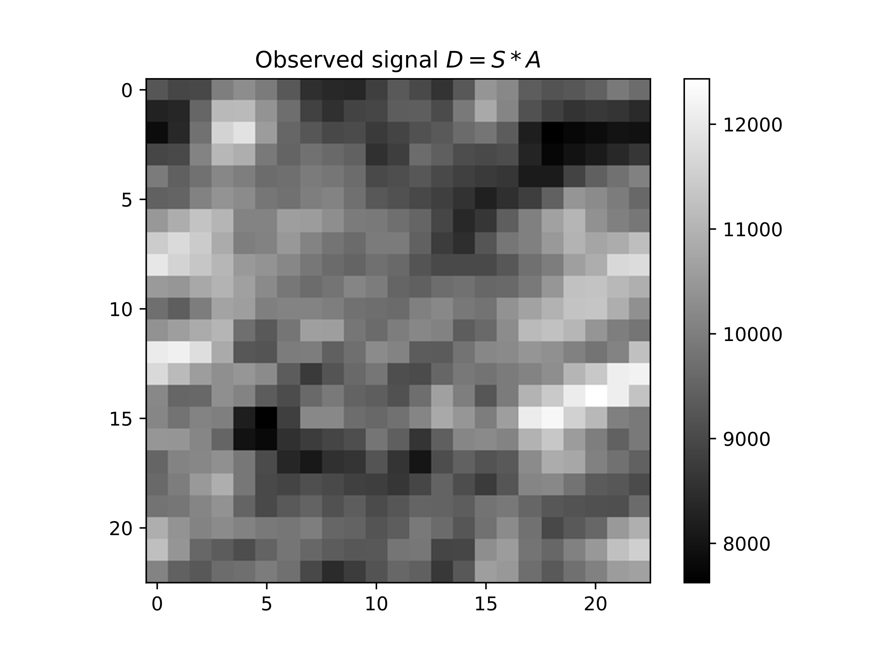
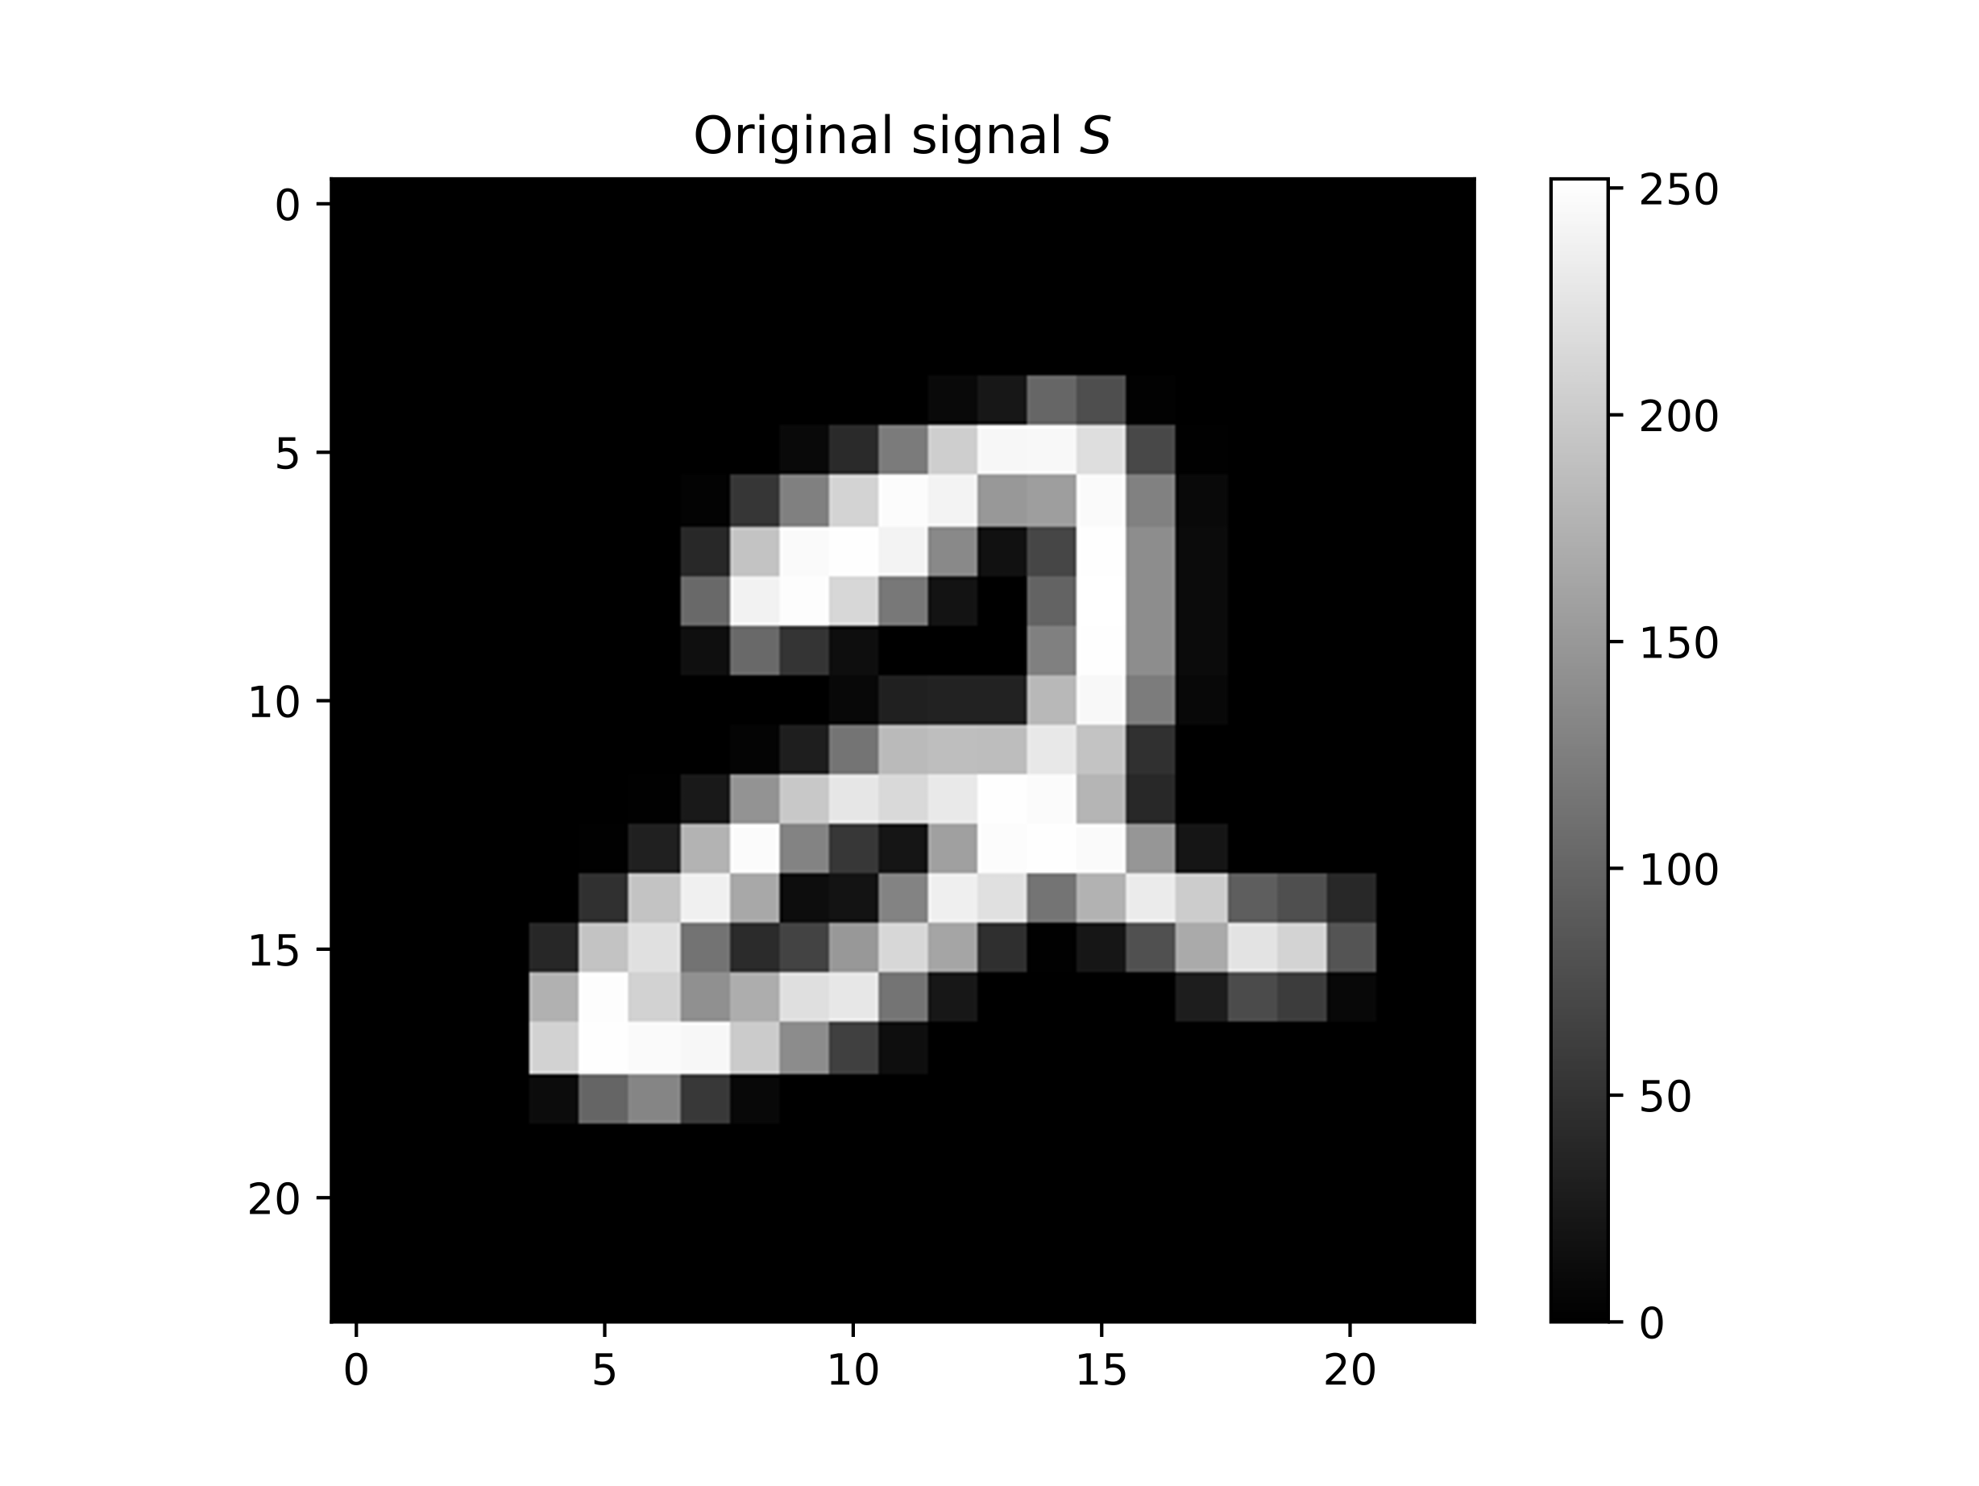
Reconstruction Architecture
The CNN consists of one convolutional layer
kernel = 23
Padding = 11
1 x 23 x 23
1 x 23 x 23
1 x 23 x 23
Convolution

Slide 5
Getting a baseline (target) for the model
Classification accuracy: 98.99% (of 10,000 test images)
The top misclassified digits: 9,4,6,7
9 – misclassified as 4,5,7,8
4 – misclassified as 9,6,2
6 – misclassified as 0,1,3,4,5,8
7 – misclassified as 1,2,4,5,9
1
Classify original MNIST images

Slide 6
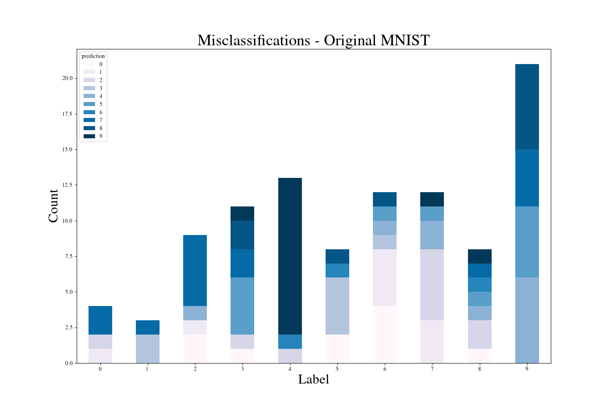

Slide 7
Classifying encoded images doesn’t do too bad
Classification accuracy: 95.35% (10,000 test images)
The top misclassified digits are: 5,7,3,8,9
5 – misclassified as 0, 8, 9, 3, 6, 4, 2
7 – misclassified as 9, 2, 4, 3, 0, 8
3 – misclassified as 8, 7, 5, 9, 2, 1, 0
8 – misclassified as 0, 6, 4, 2, 9, 5, 3, 7
9 – misclassified as 8, 3, 0, 4, 5, 7, 6, 1, 2
2
Classify encoded MNIST images

Slide 8
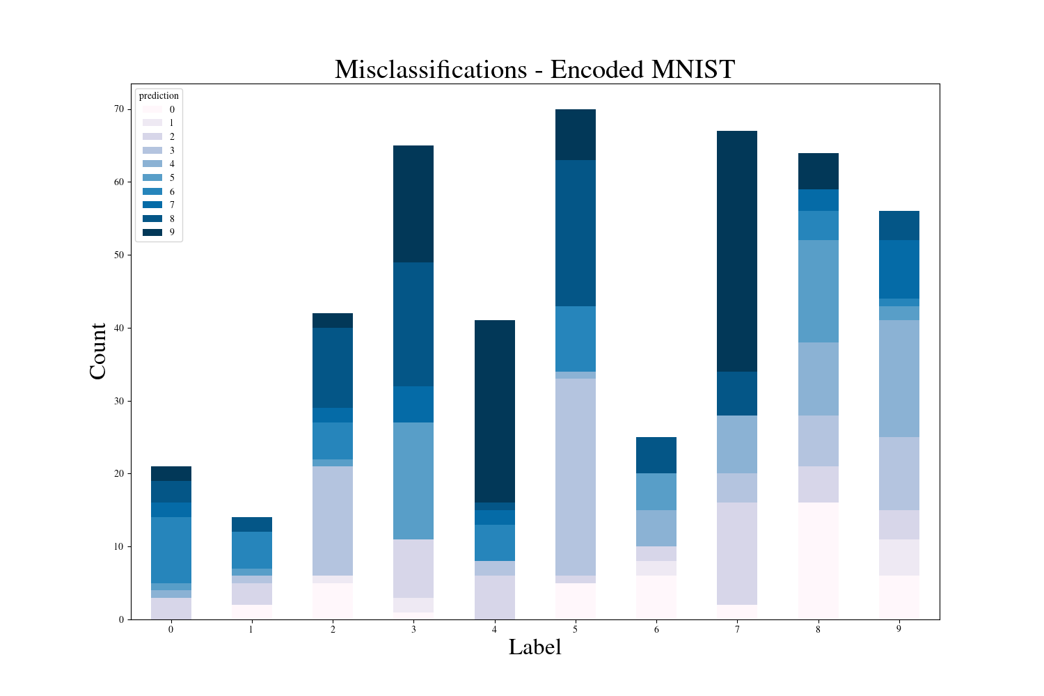

Slide 9
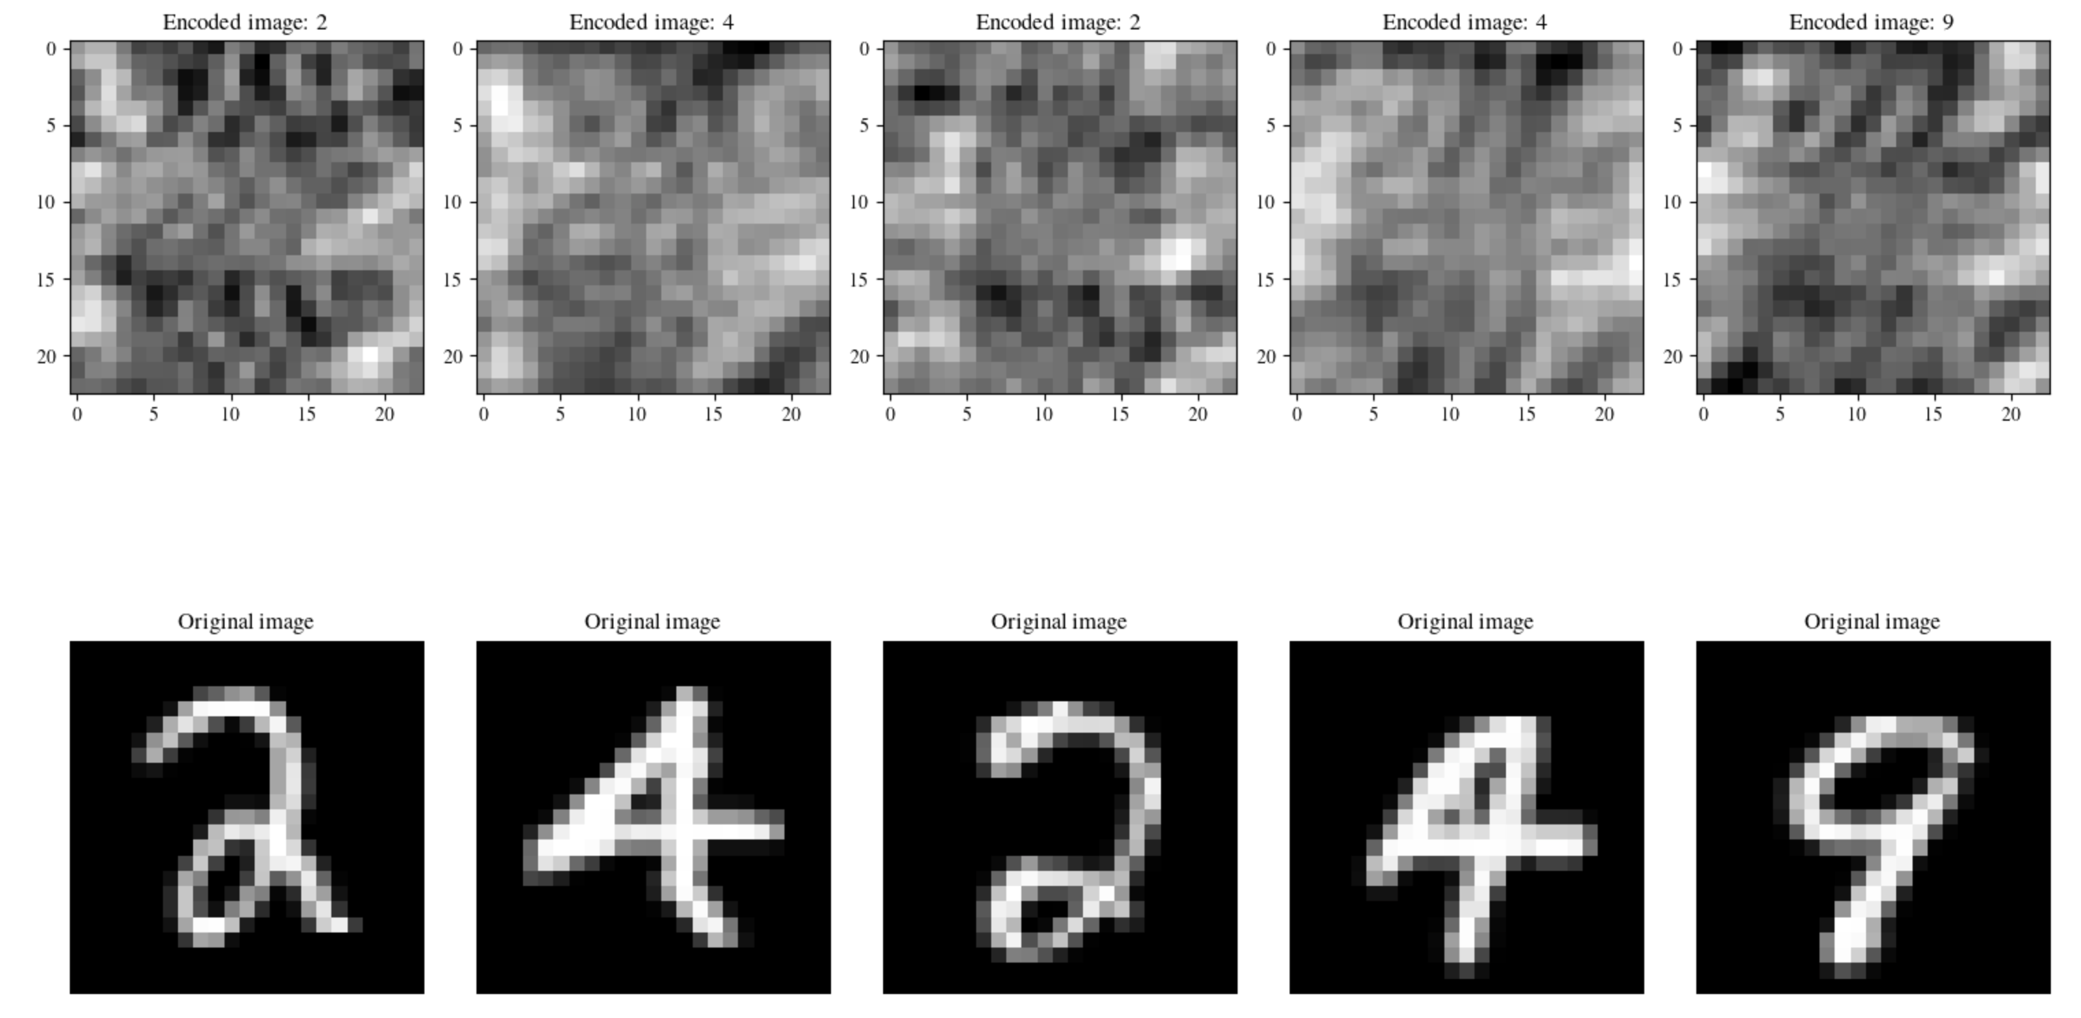
What if we try to reconstruct first?
Input
3
Reconstruct encoded MNIST images, then classify from reconstructions
CNN with Sigmoid activation
CNN with NO activation
Target

Slide 10
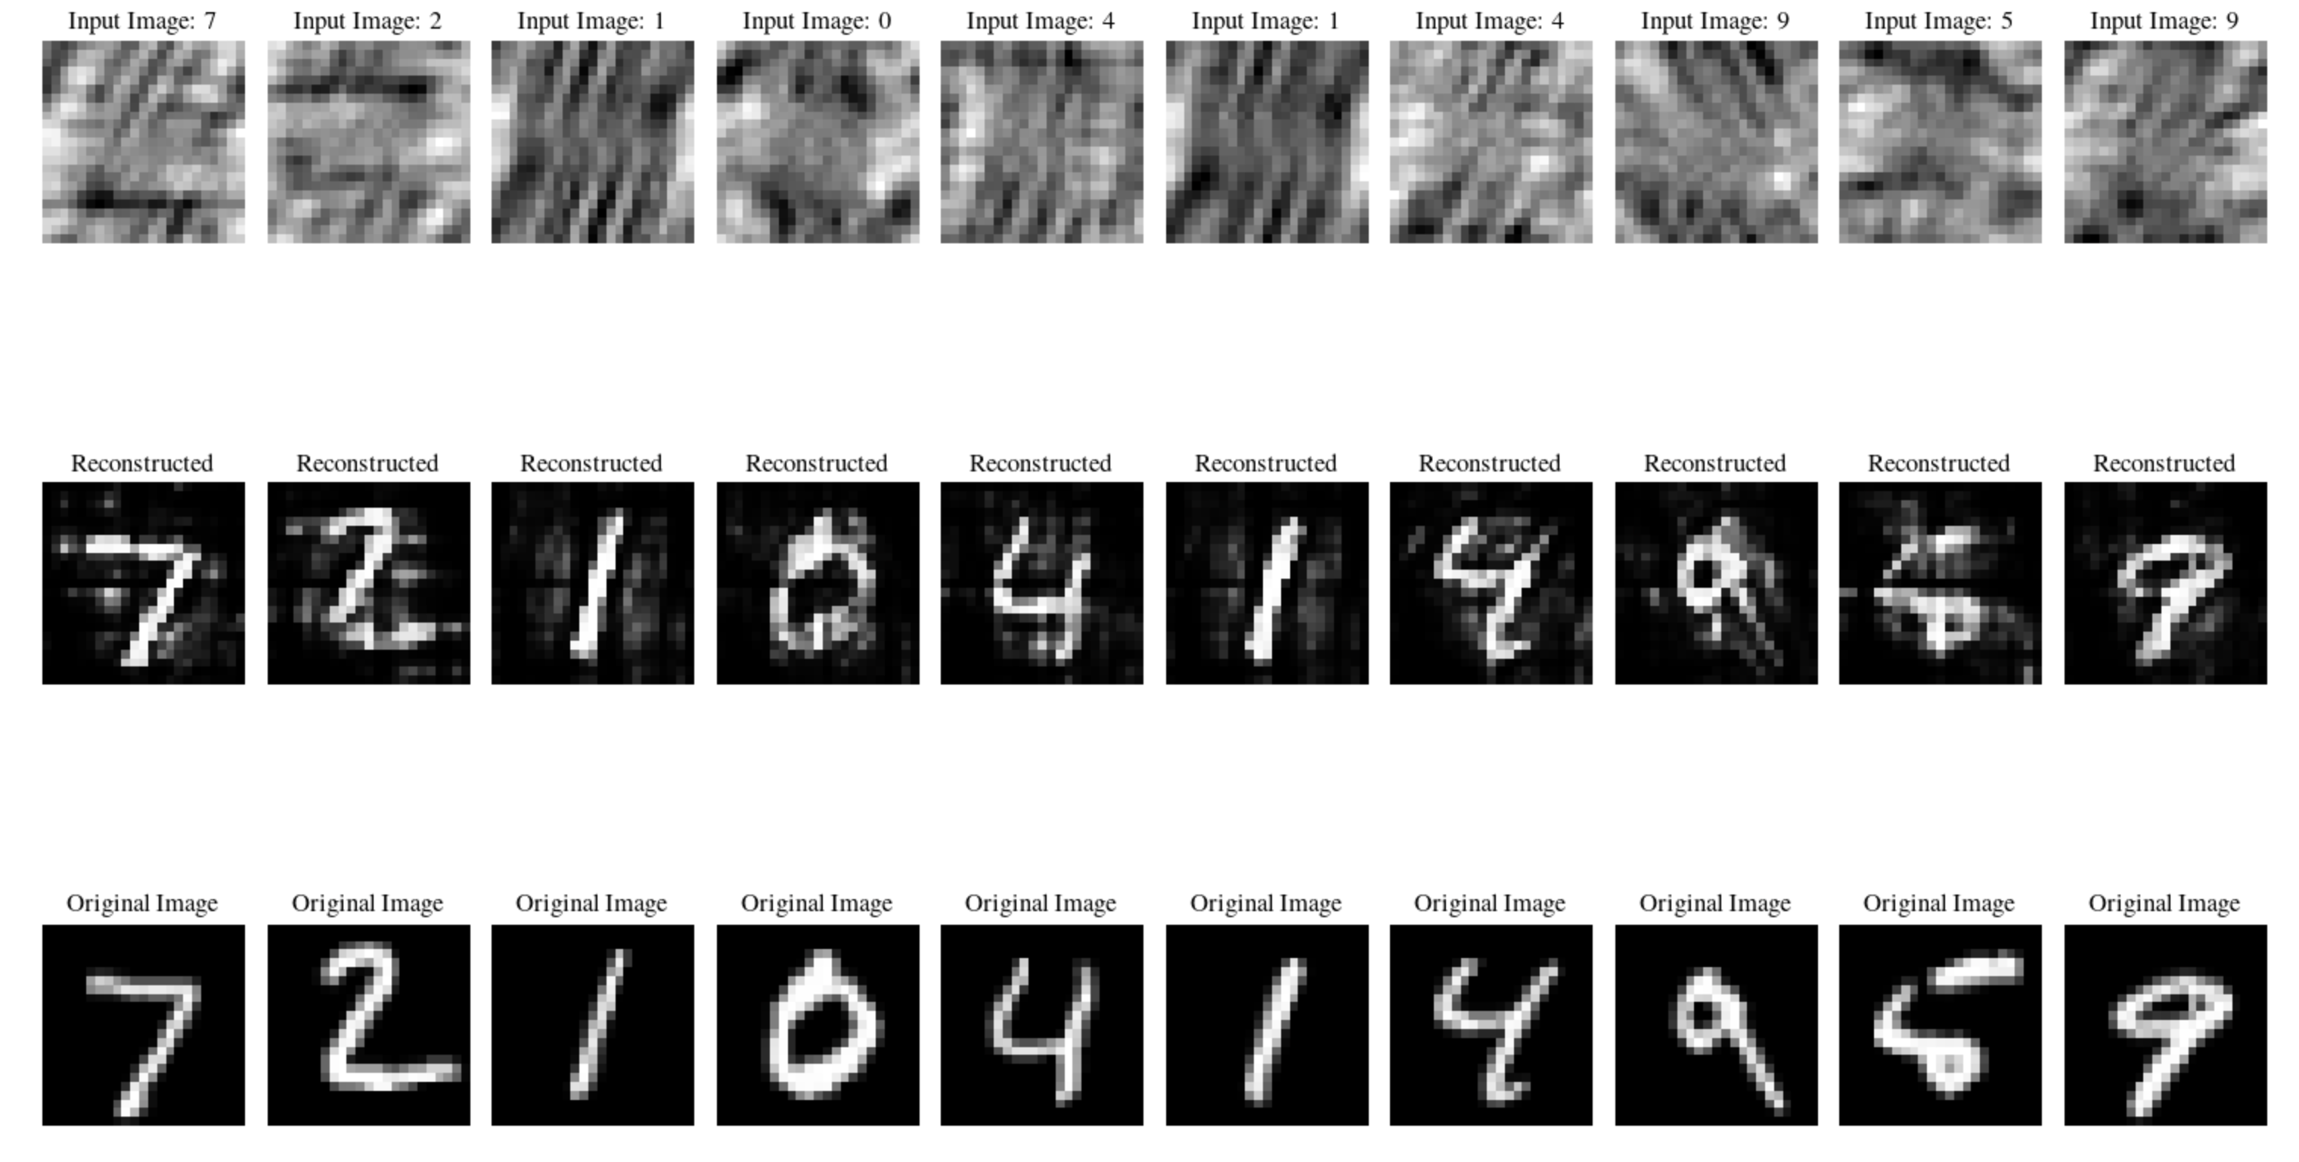
Reconstructions using Sigmoid Activation

Slide 11
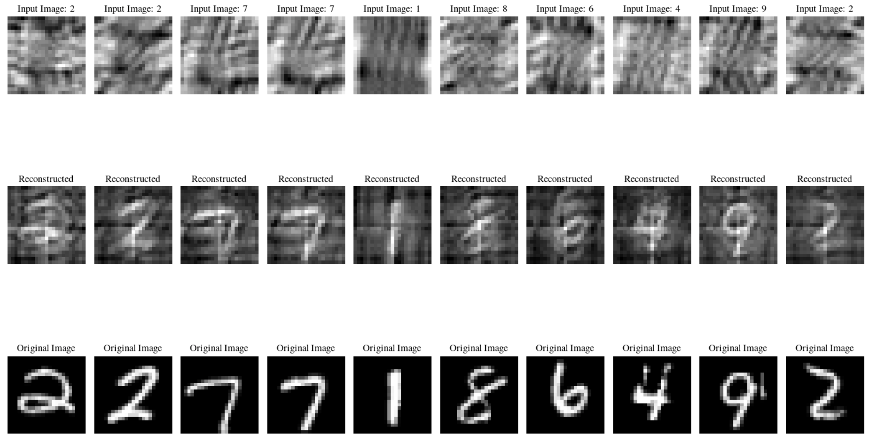
Reconstructions using NO Activation

Slide 12
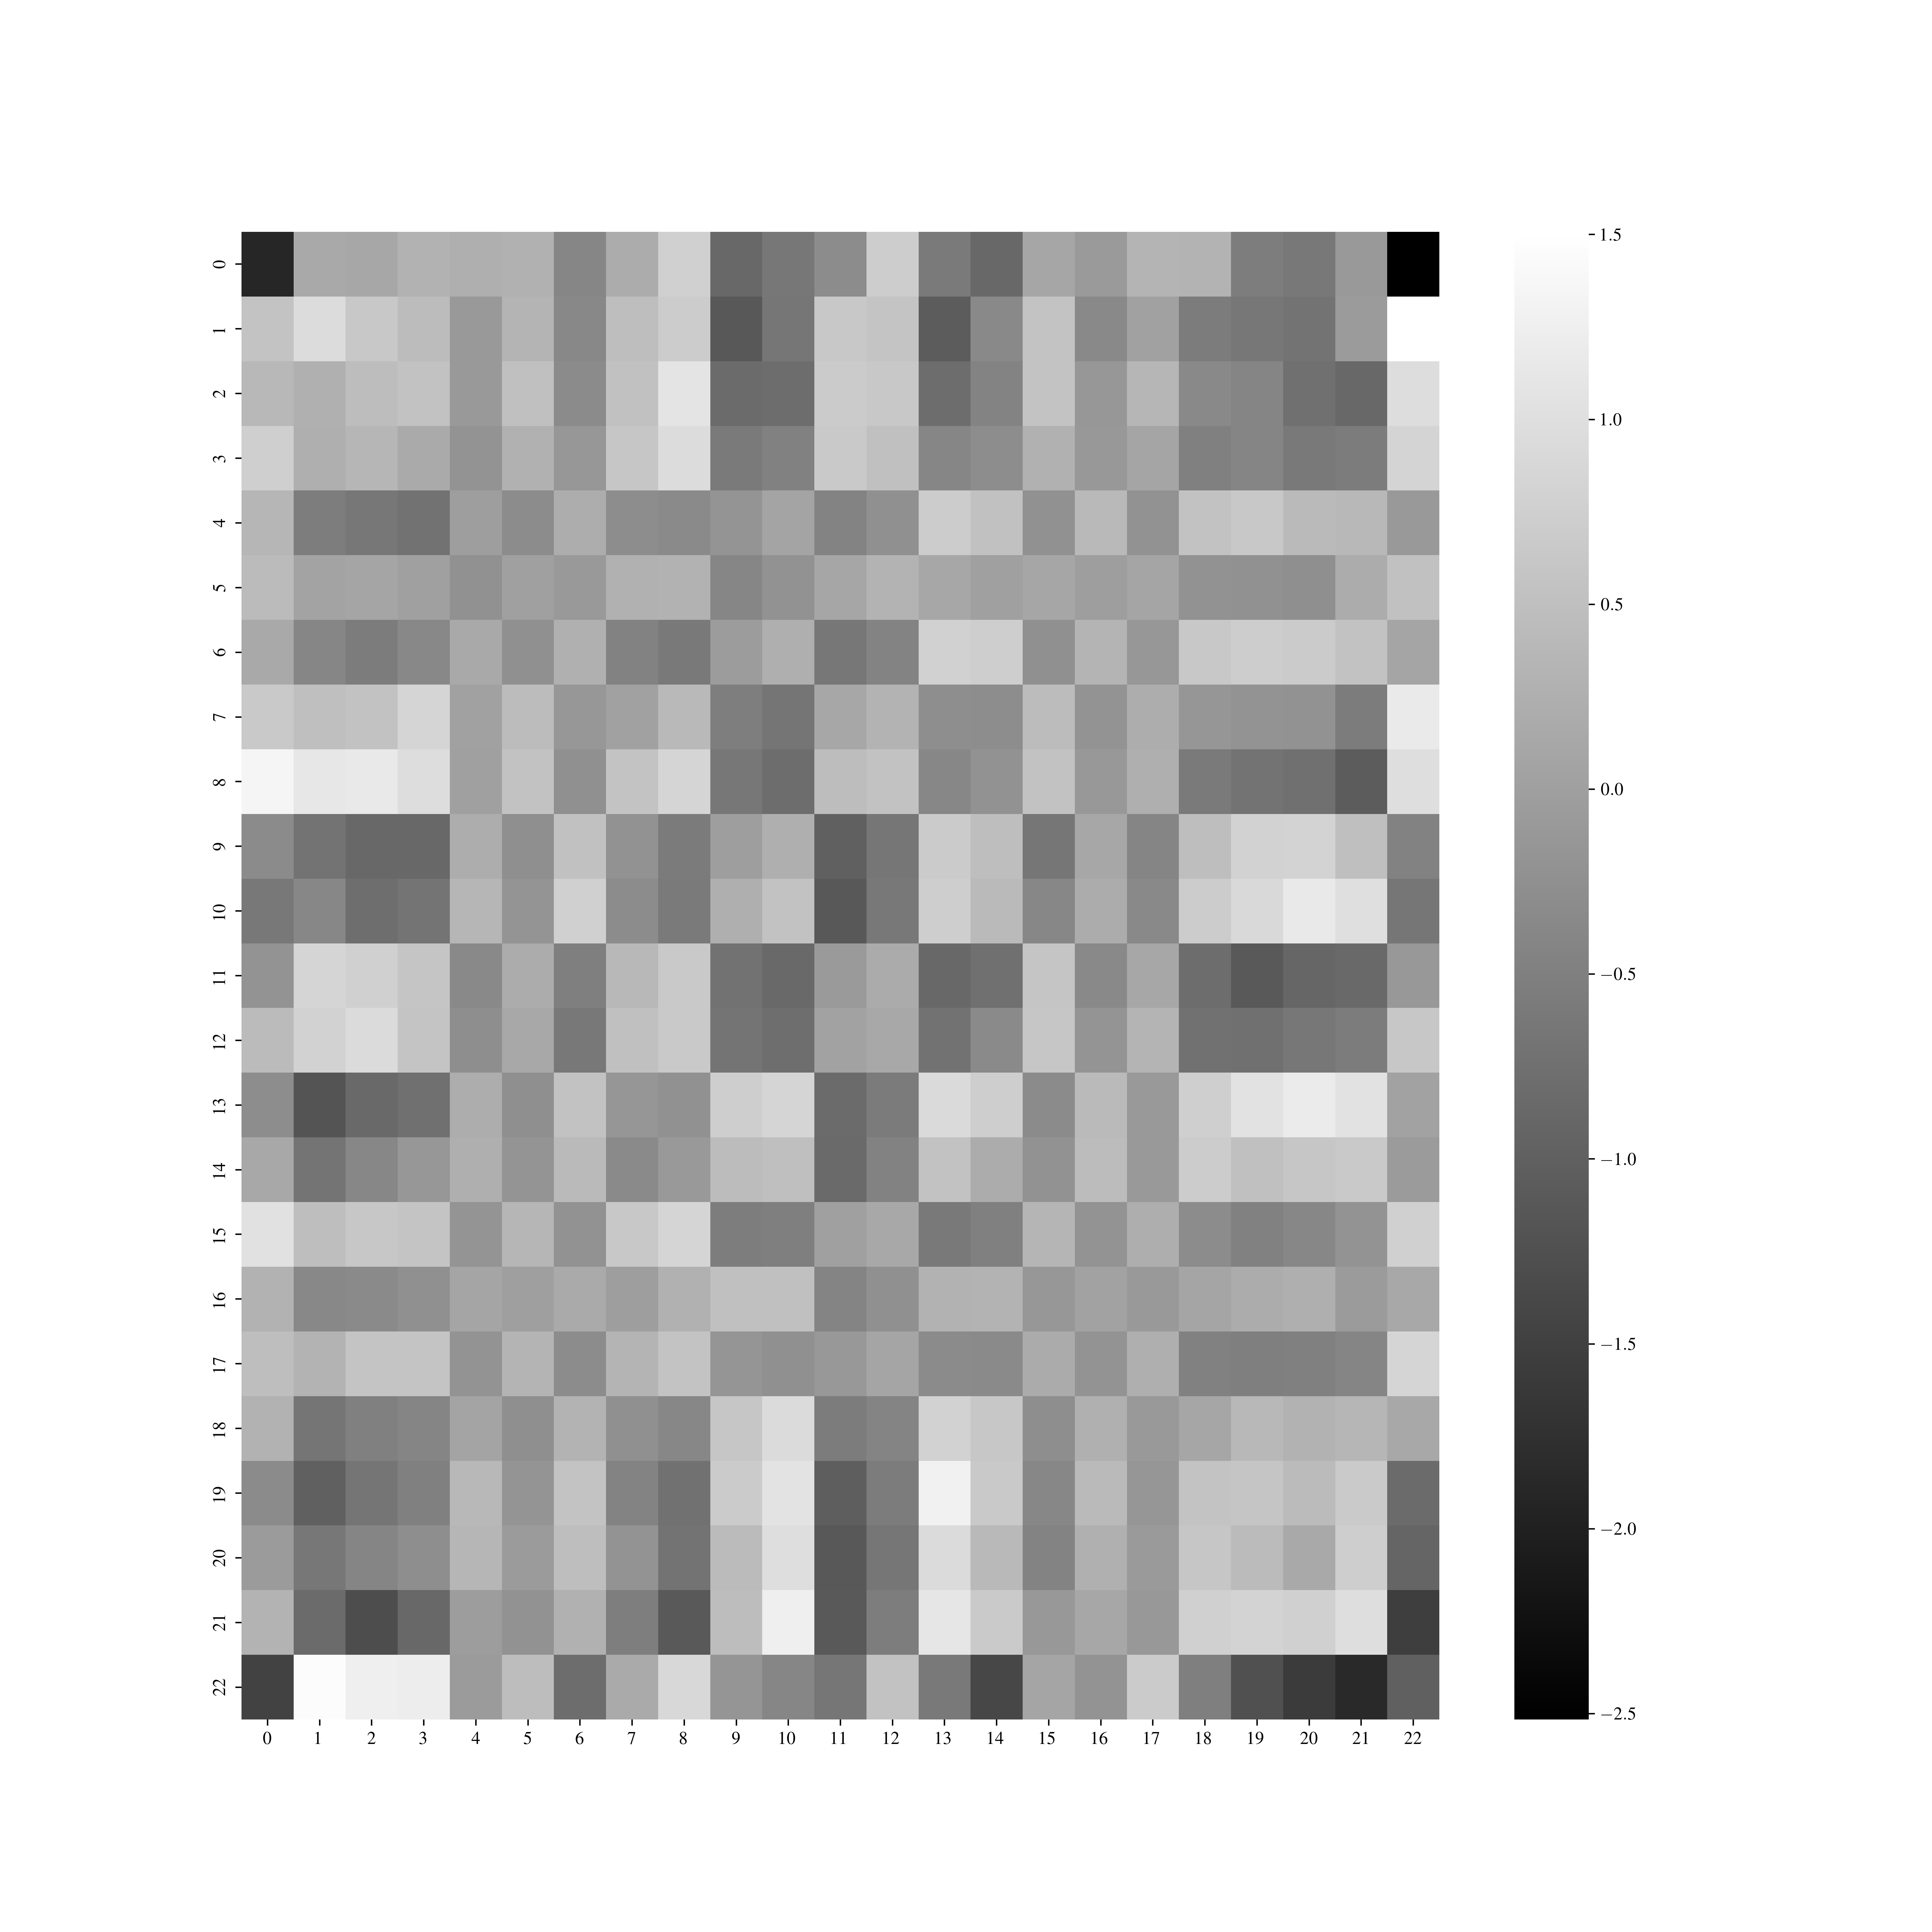
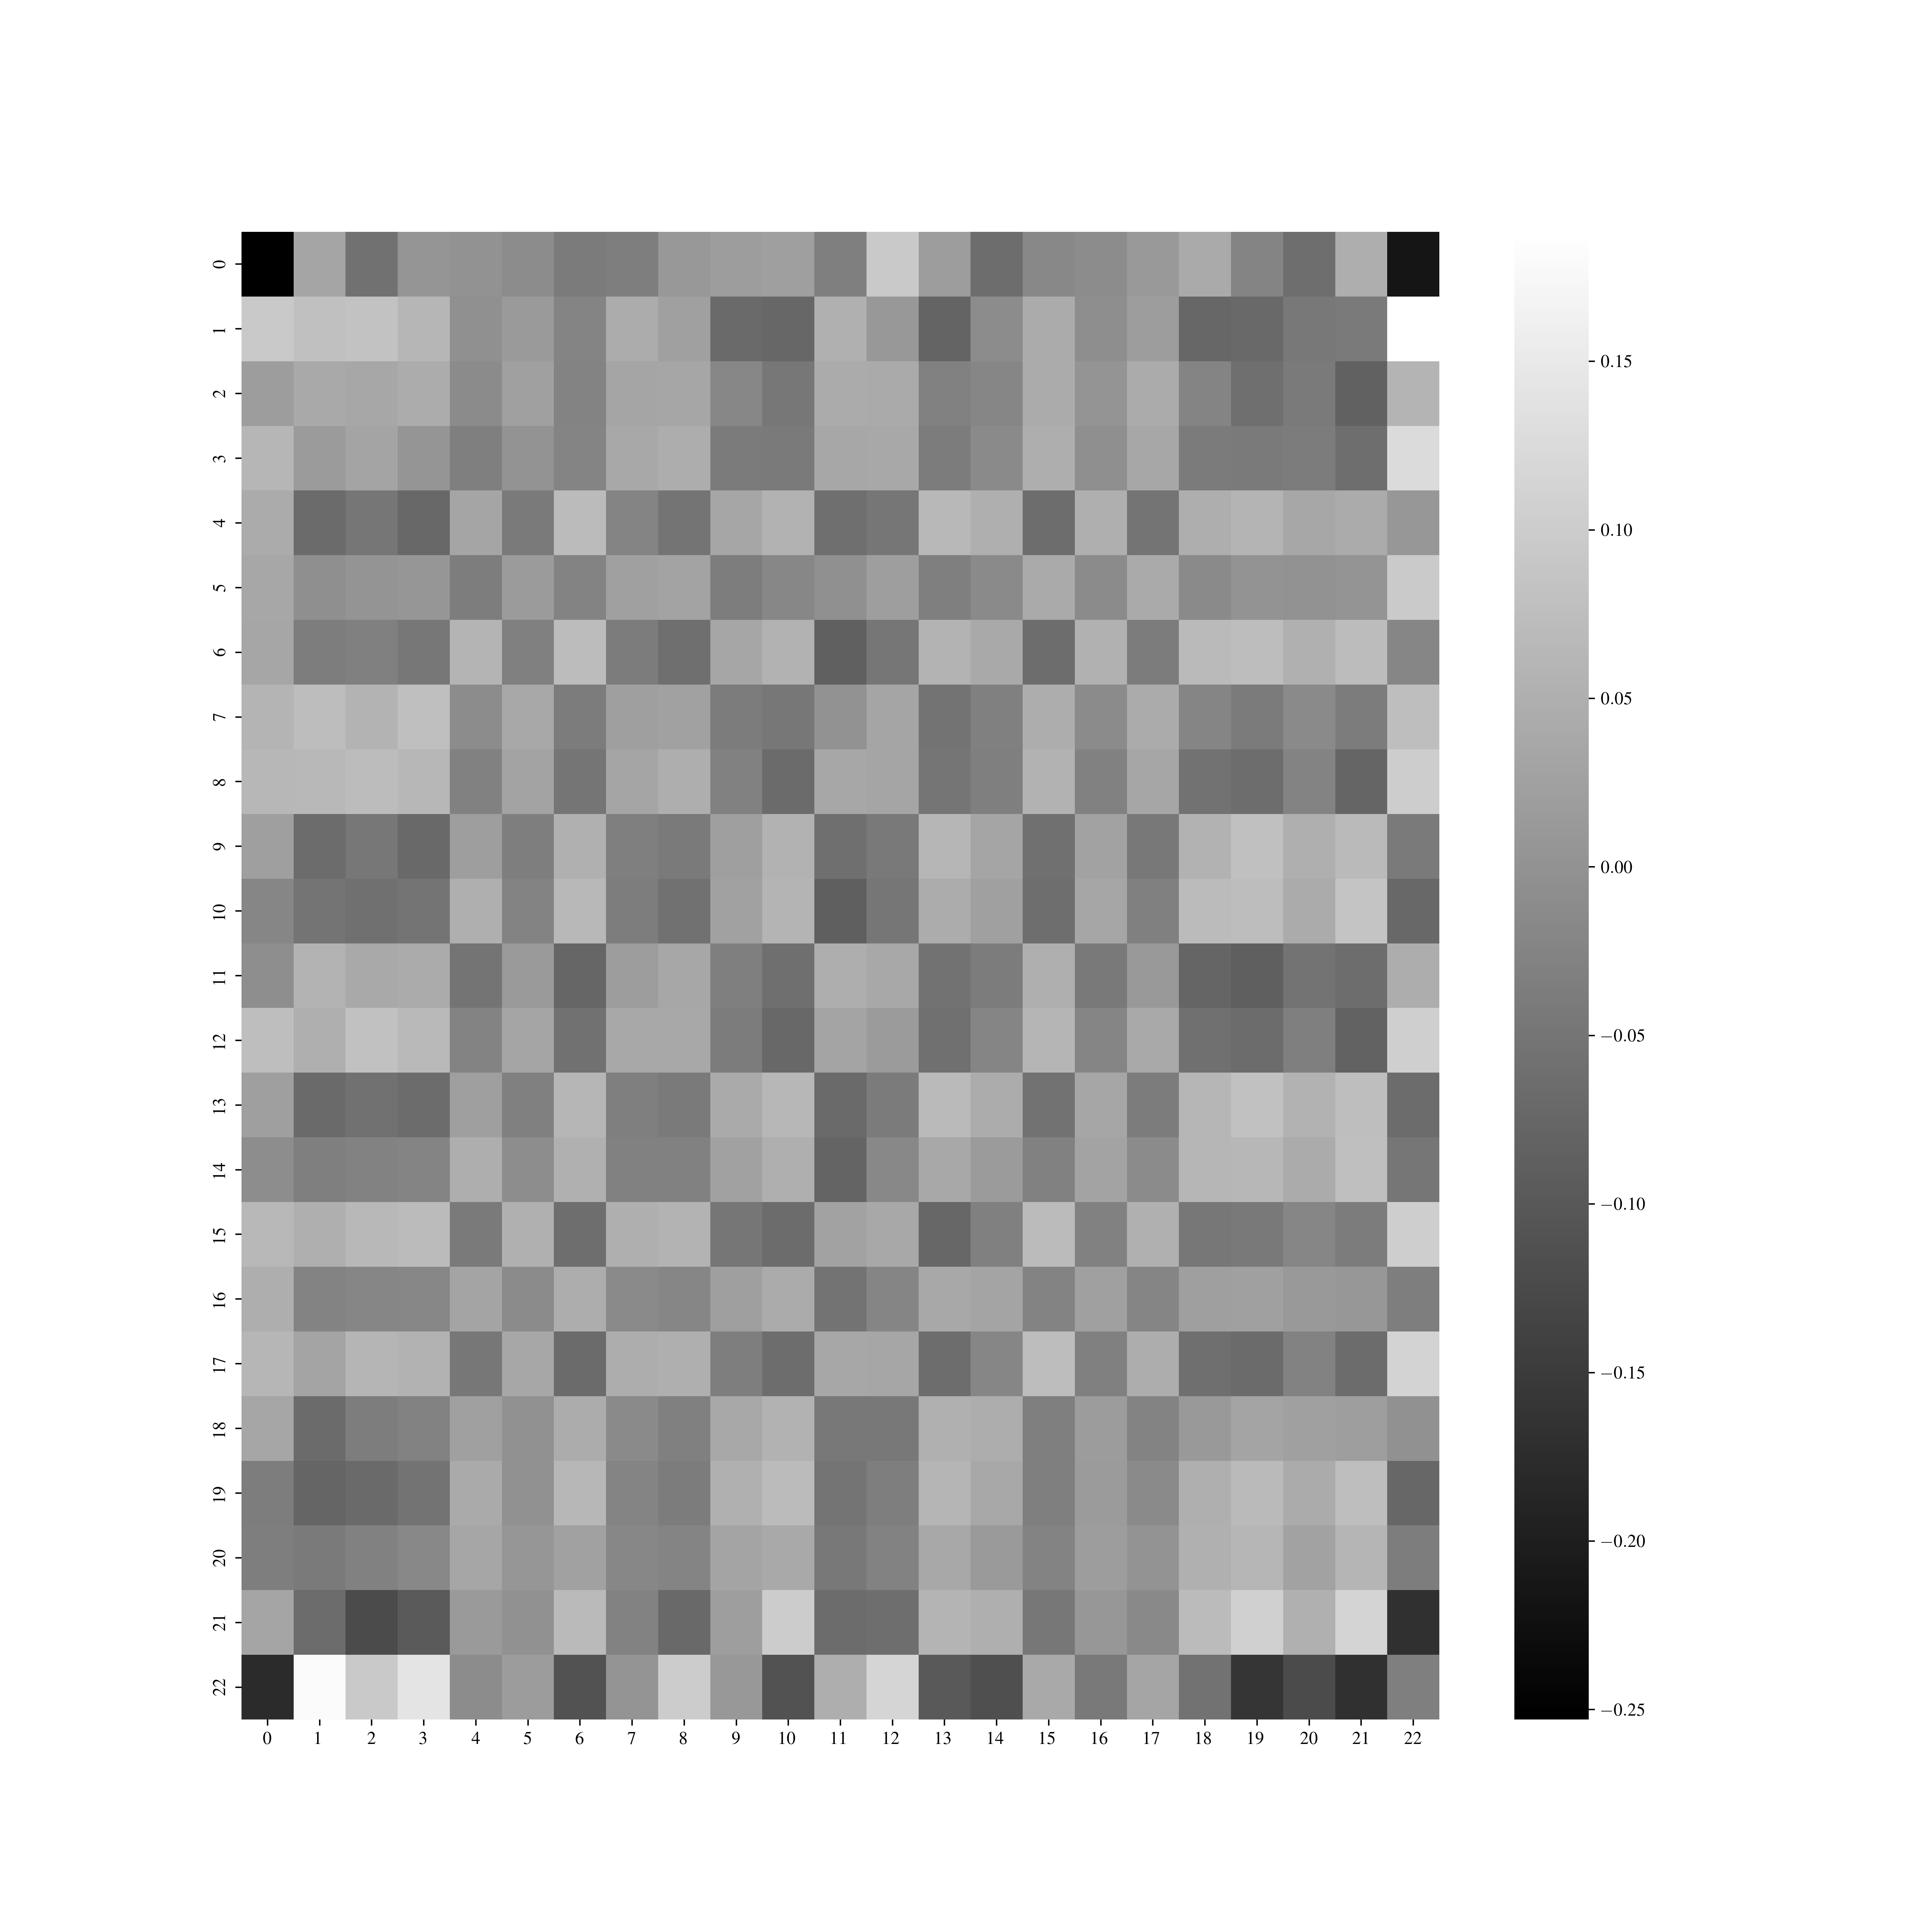
How do the weights differ?
Sigmoid activation
NO activation

Slide 13
Tuesday, April 11, 2023

Slide 14
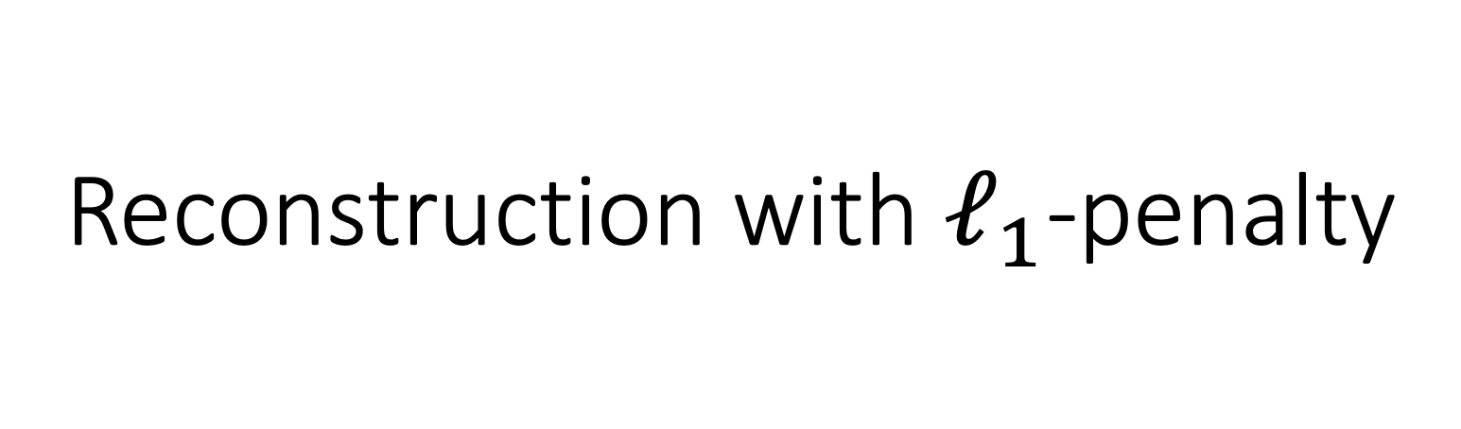
Reconstruction with $ℓ_{1}$-penalty

Slide 15
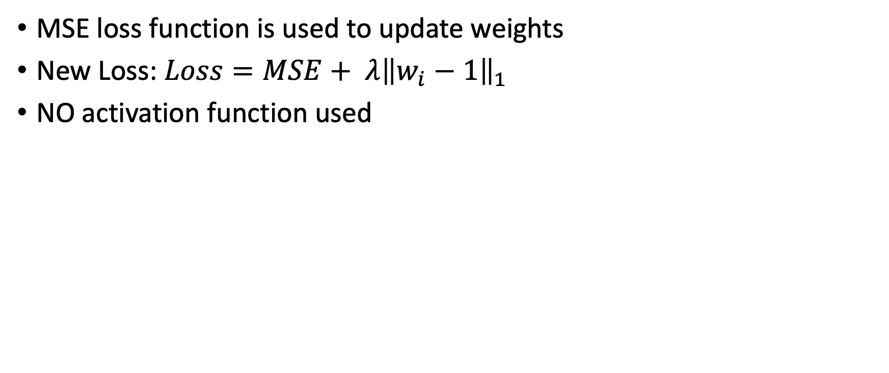
Constraining the weights with a penalty
MSE loss function is used to update weights
New Loss: $Loss=MSE+ λ{\left\|w_{i}−1\right\|}_{1}$
NO activation function used
Notes:
Started with lambda=1 and then went smaller
There was an error in the code and the notation in this slide is not accurate

Slide 16
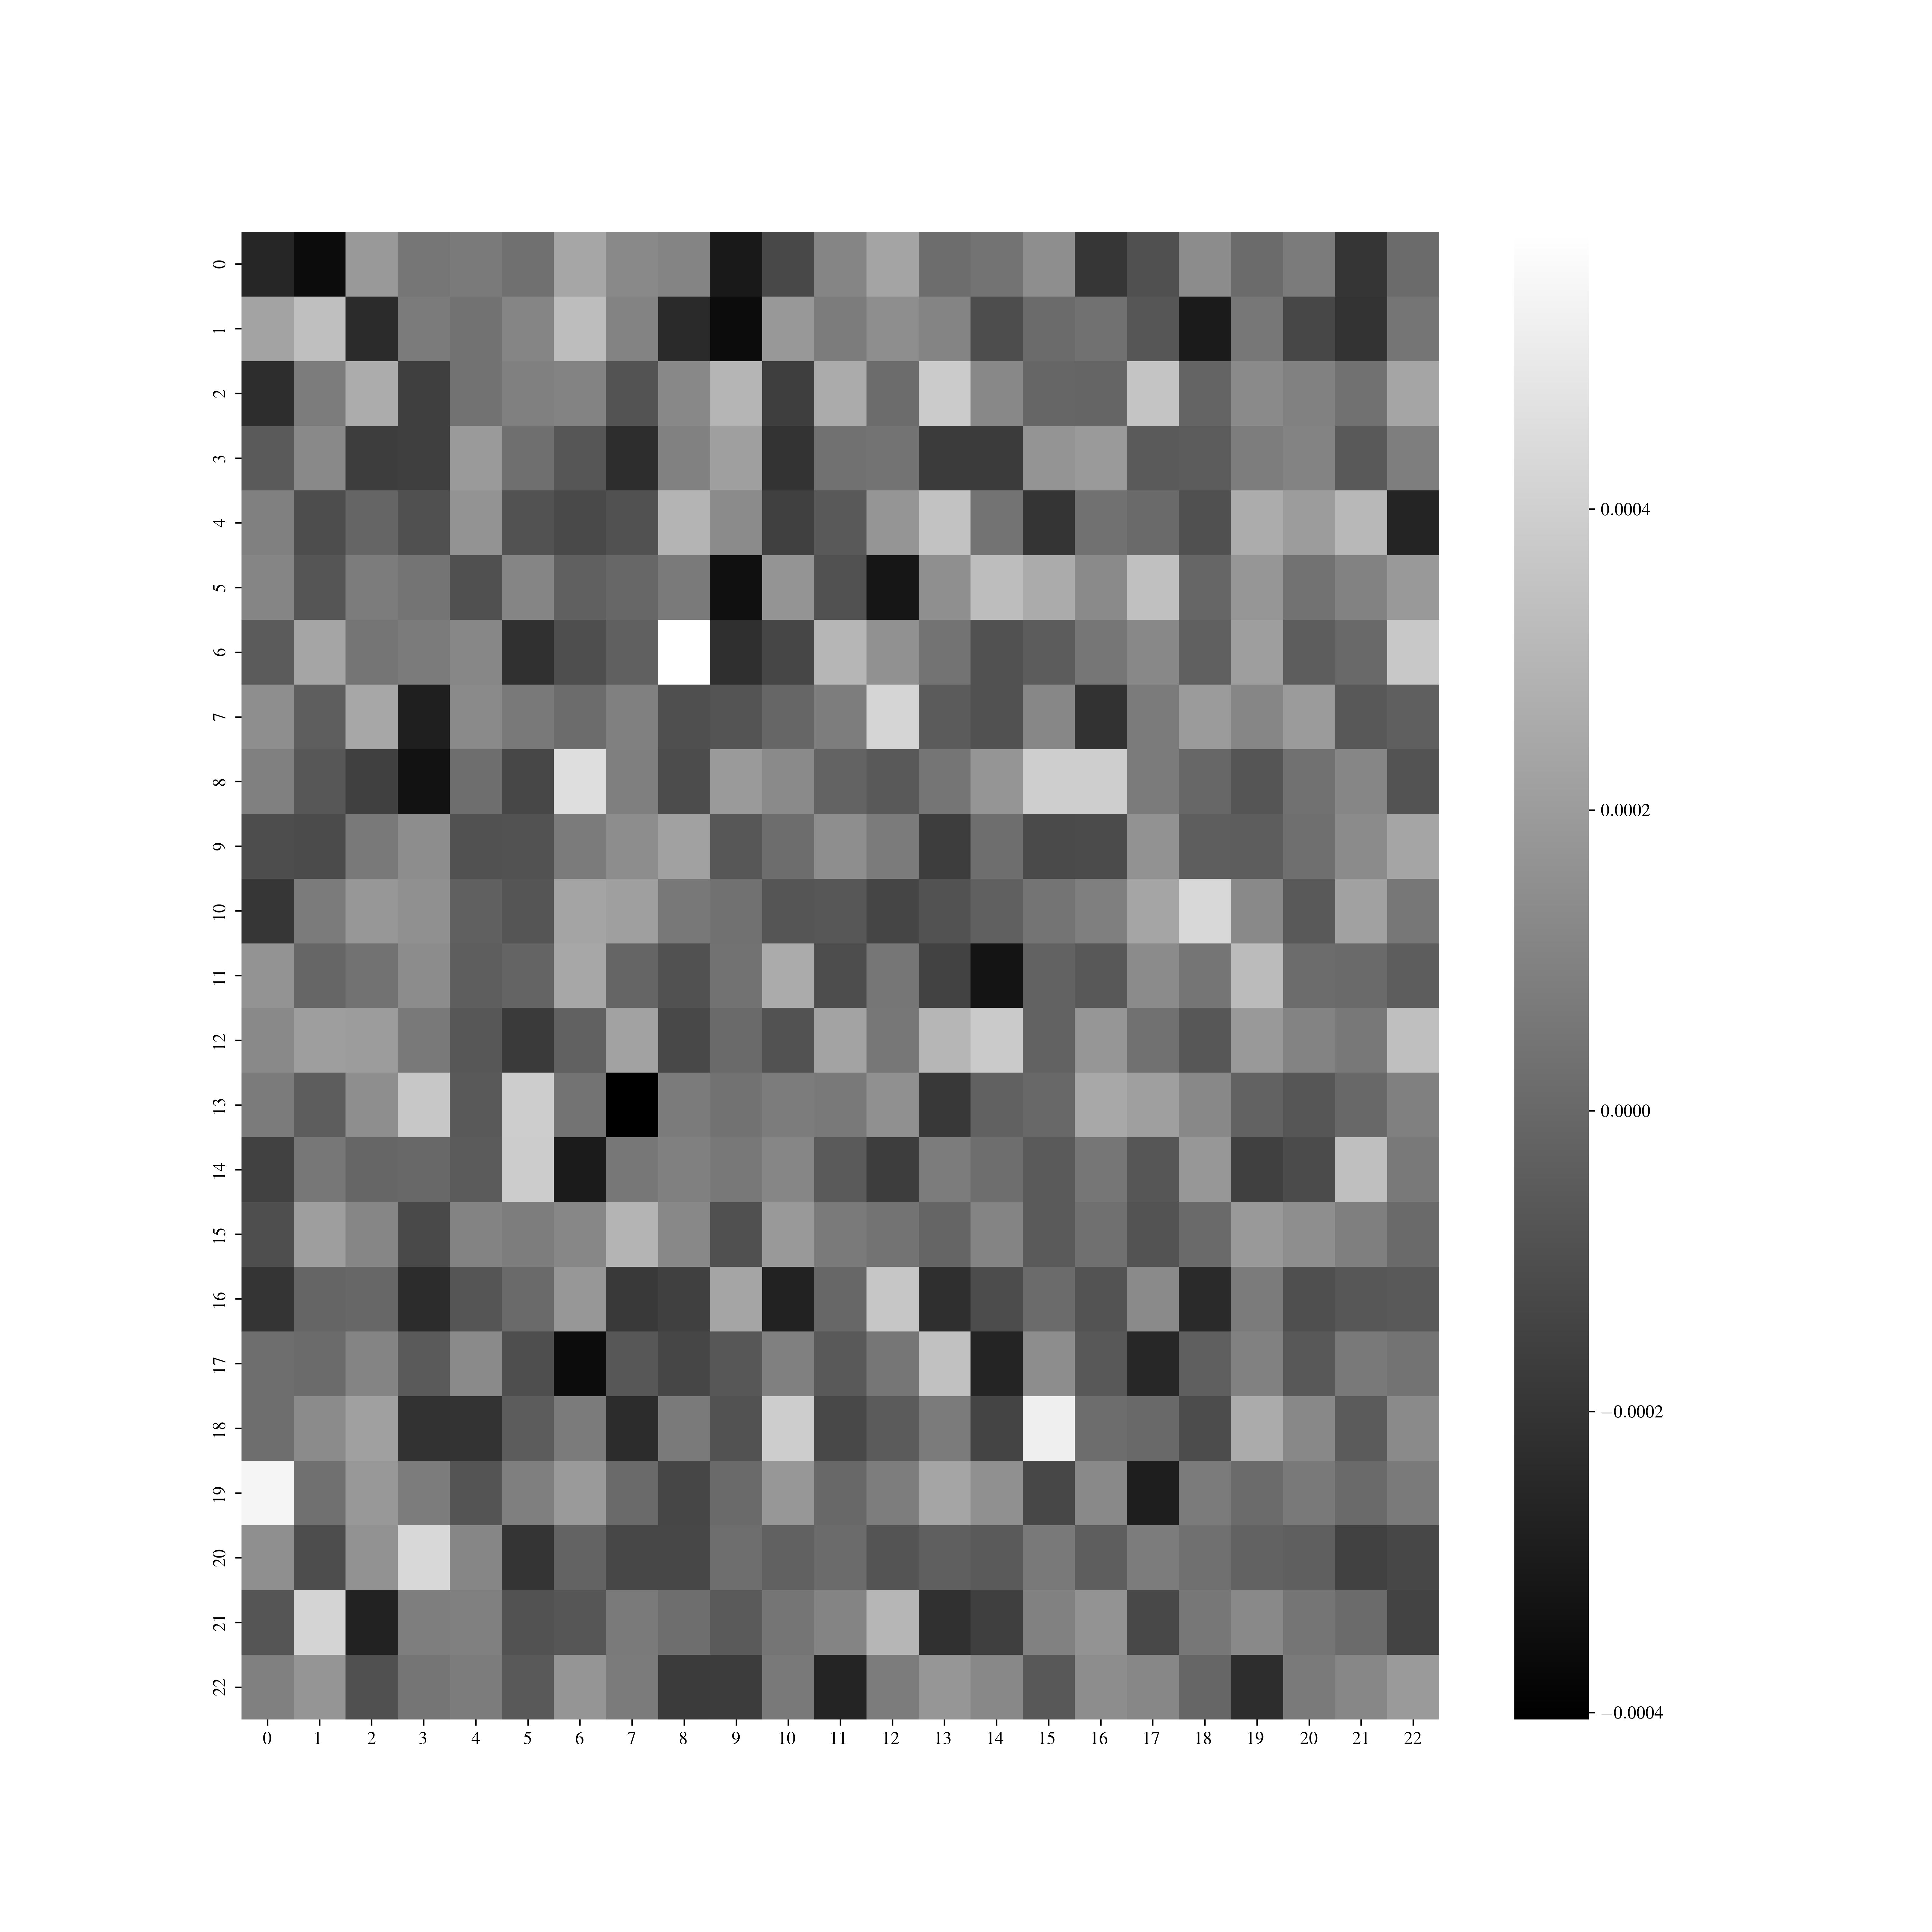
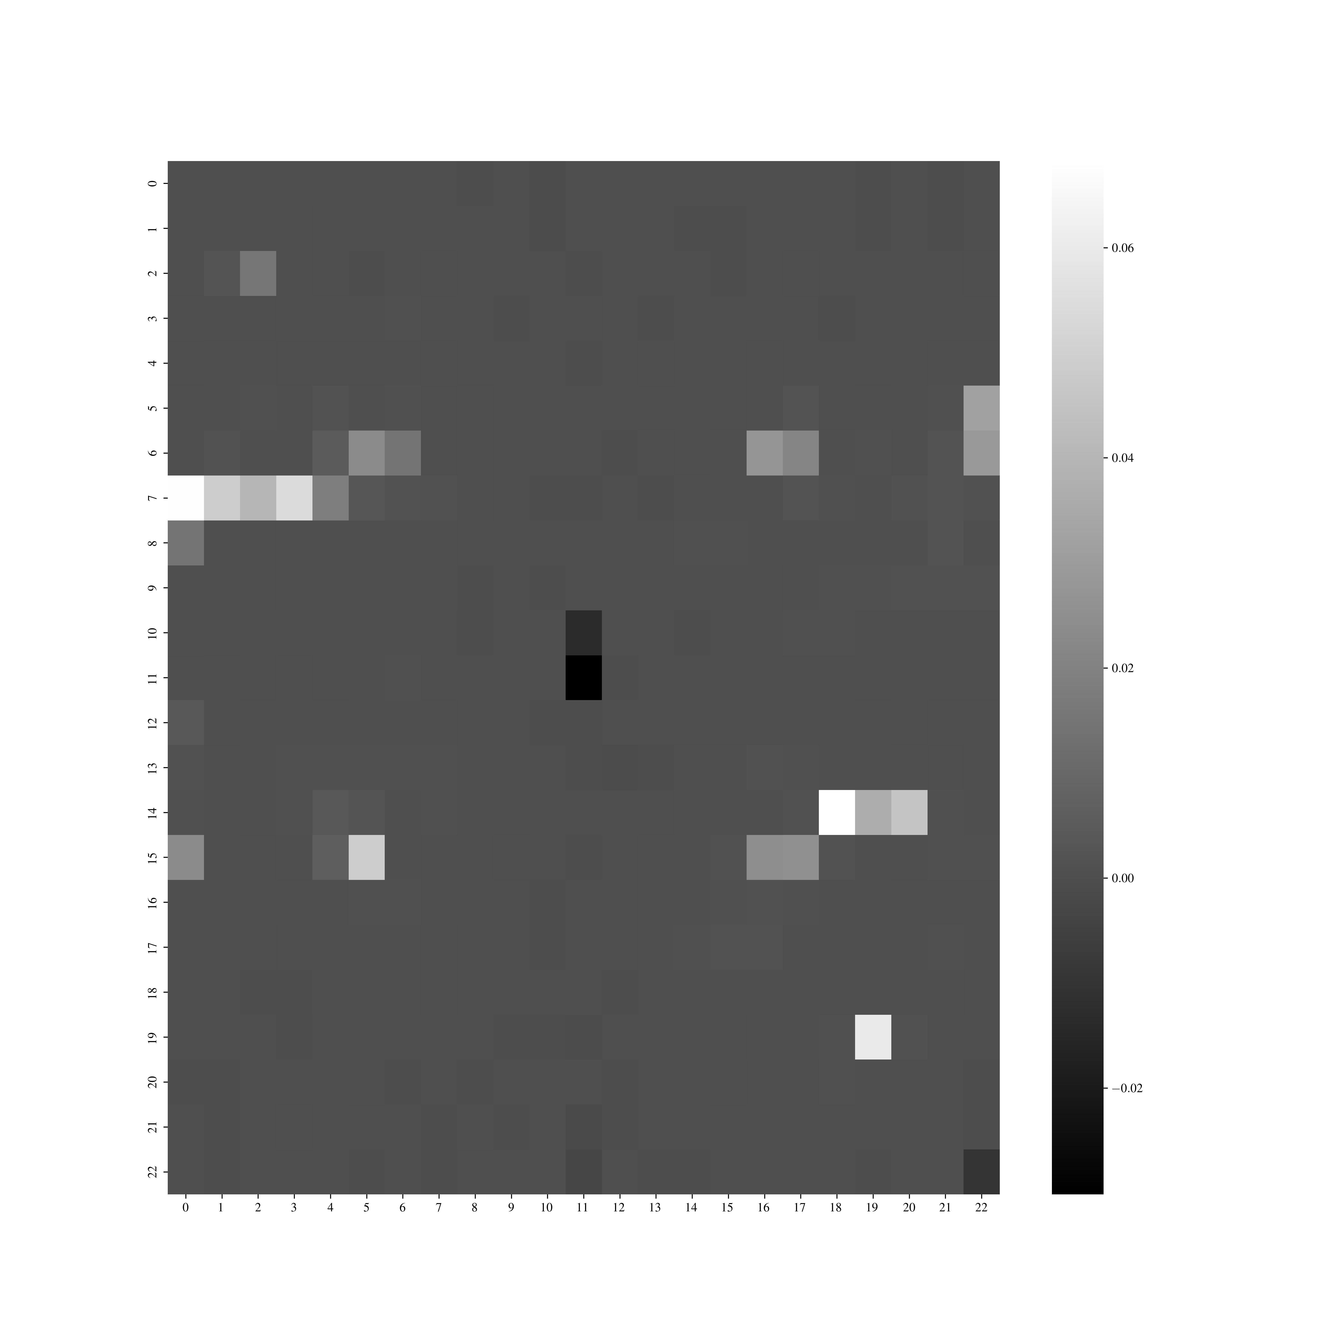
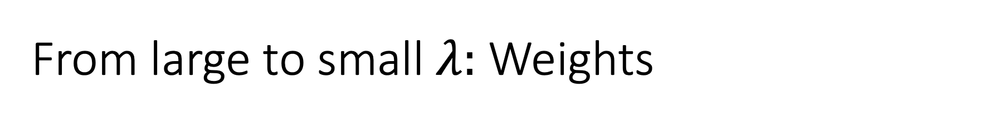
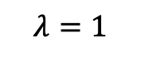
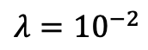
From large to small $λ:$ Weights
$$λ=1$$
$$λ={10}^{−2}$$

Slide 17
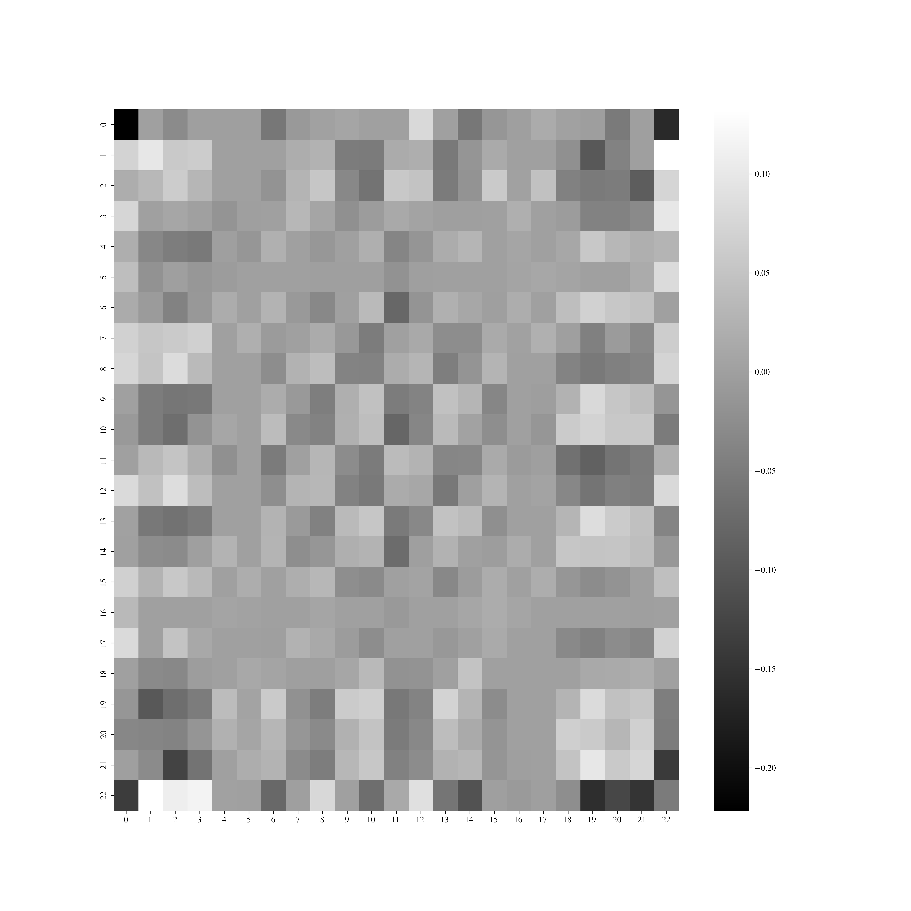

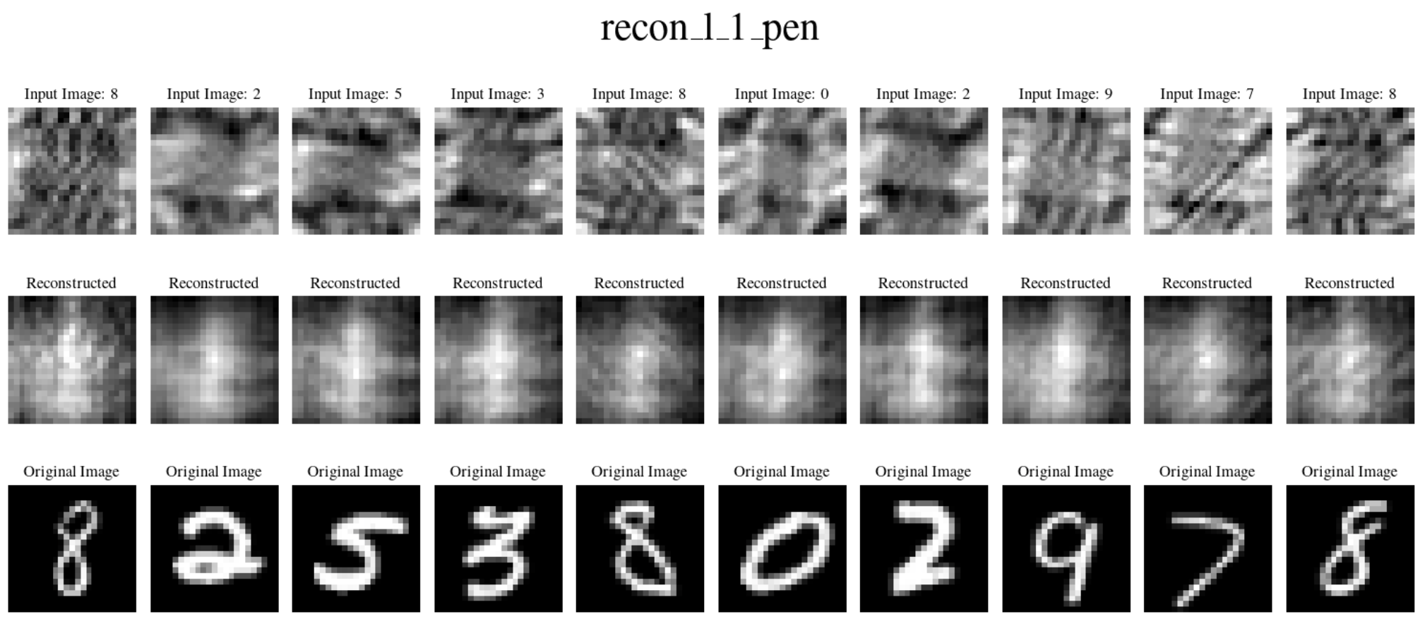
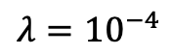
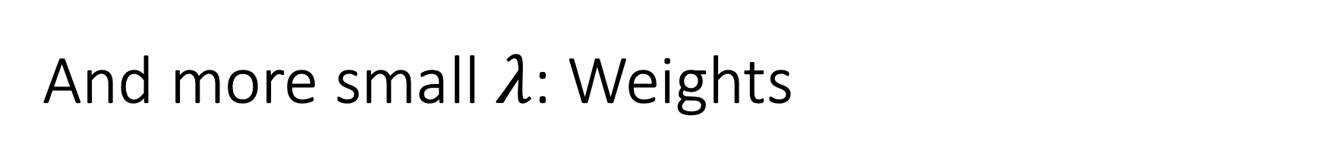
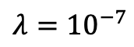
And more small $λ$: Weights
$$λ={10}^{−4}$$
$$λ={10}^{−7}$$

Slide 18
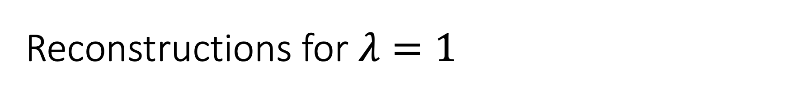
Reconstructions for $λ=1$

Slide 19
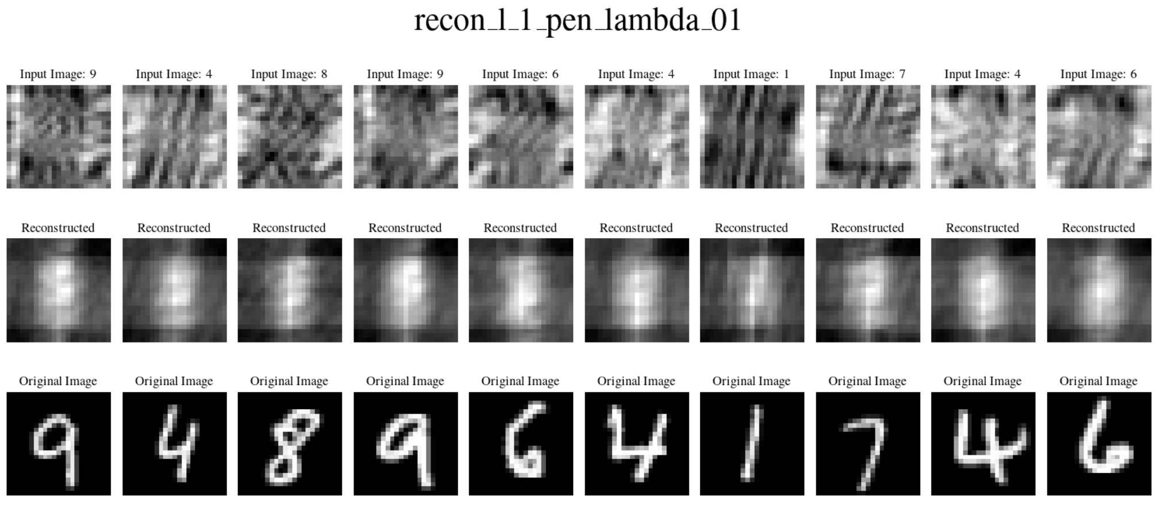
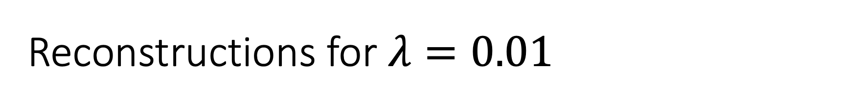
Reconstructions for $λ=0.01$

Slide 20
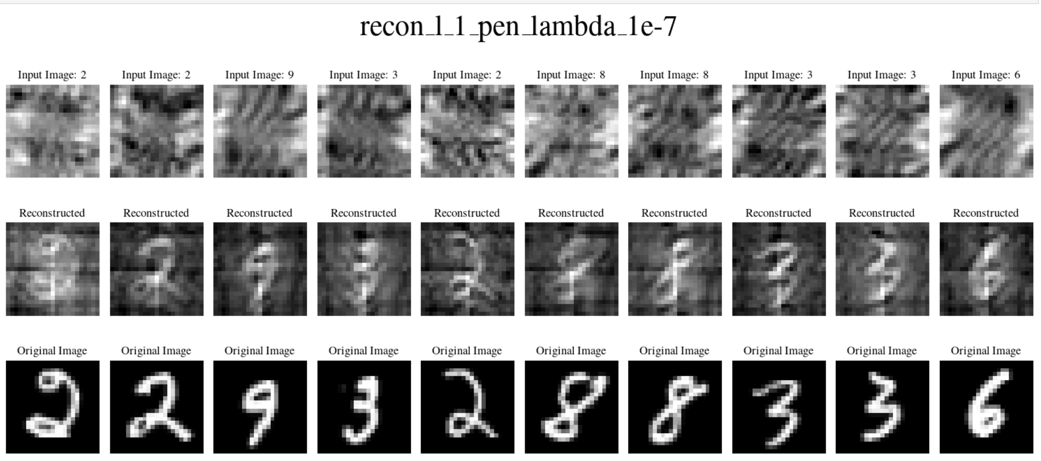
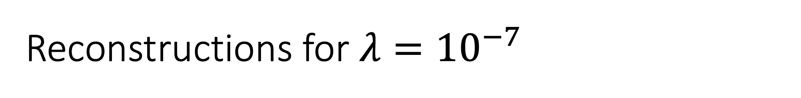
Reconstructions for $λ={10}^{−7}$

Slide 21
Thursday, April 13, 2023

Slide 22
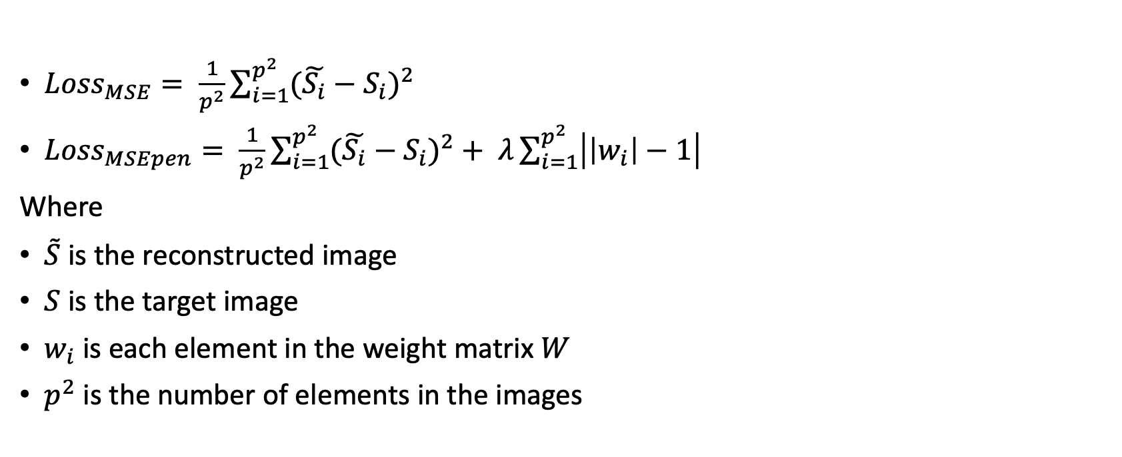
After fixing the loss:
${Loss}_{MSE}= \frac{1}{p^{2}}\sum_{i=1}^{p^{2}}{{(\tilde{S_{i}}−S_{i})}^{2}}$
${Loss}_{MSEpen}= \frac{1}{p^{2}}\sum_{i=1}^{p^{2}}{{(\tilde{S_{i}}−S_{i})}^{2}}+ λ\sum_{i=1}^{p^{2}}{\left|\left|w_{i}\right|−1\right|}$
Where
$\tilde{S}$ is the reconstructed image
$S$ is the target image
$w_{i}$ is each element in the weight matrix $W$
$p^{2}$ is the number of elements in the images

Slide 23
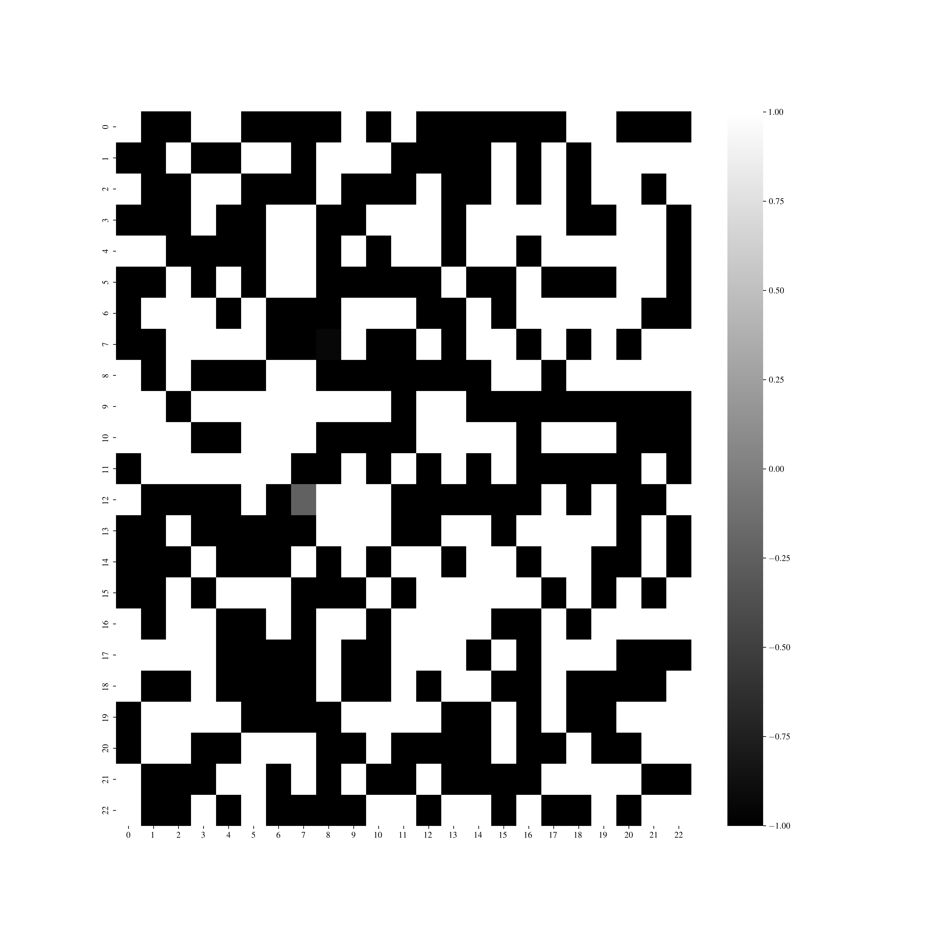
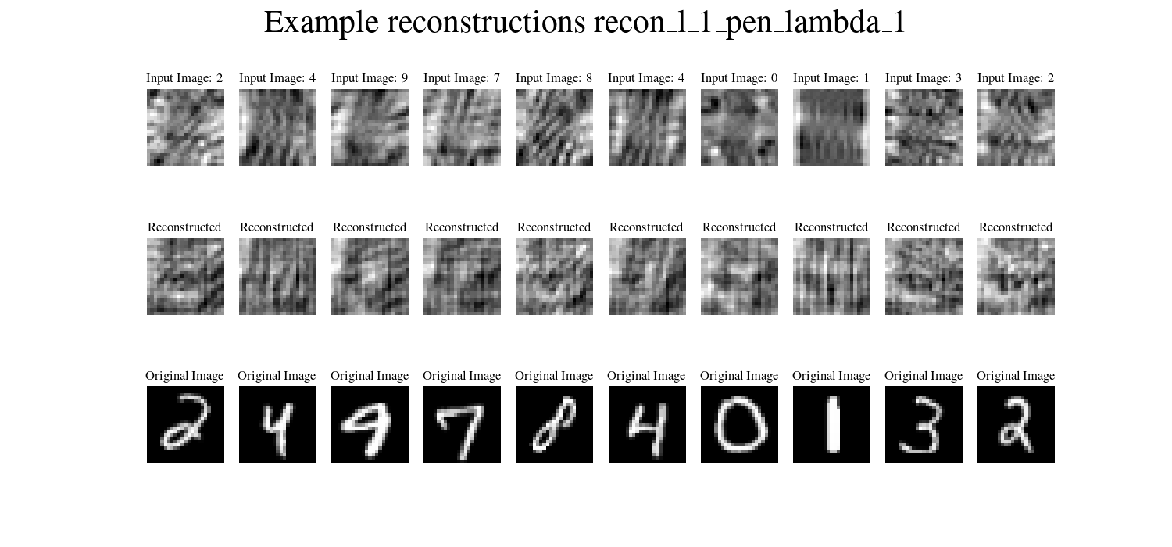
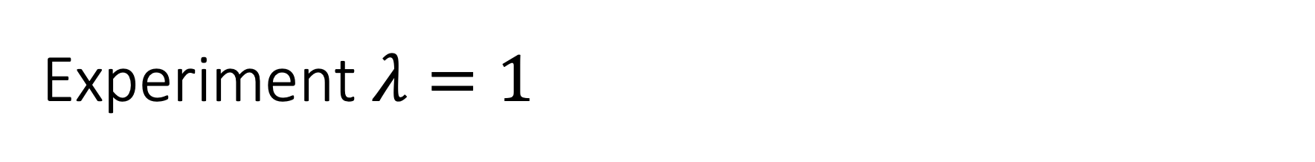
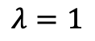
Experiment $λ=1$
$$λ=1$$

Slide 24
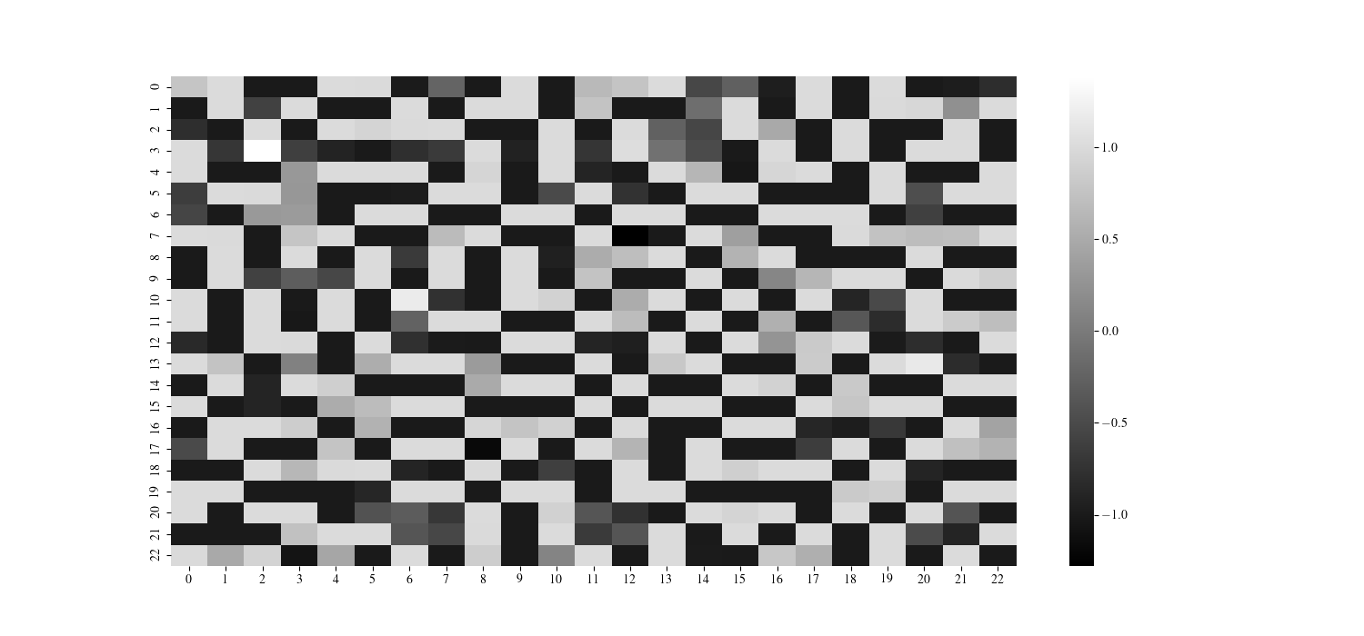
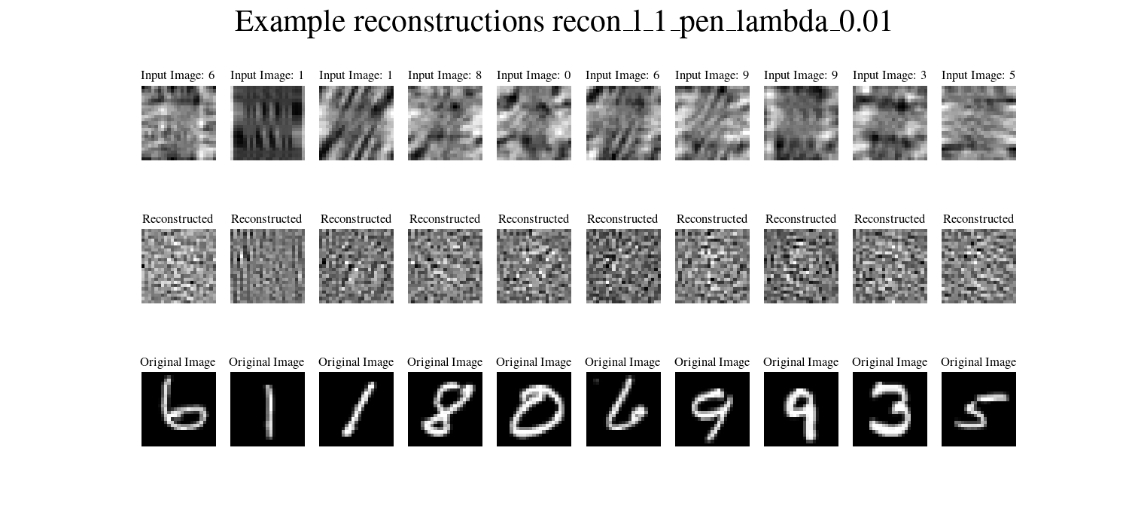
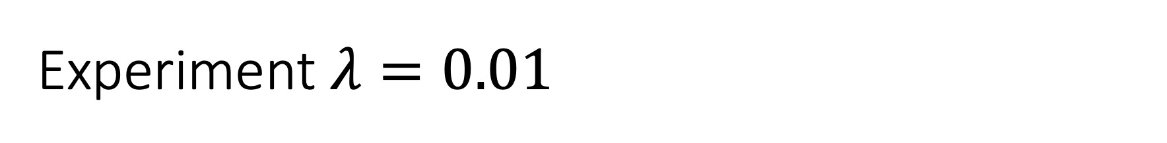
Experiment $λ=0.01$

Slide 25
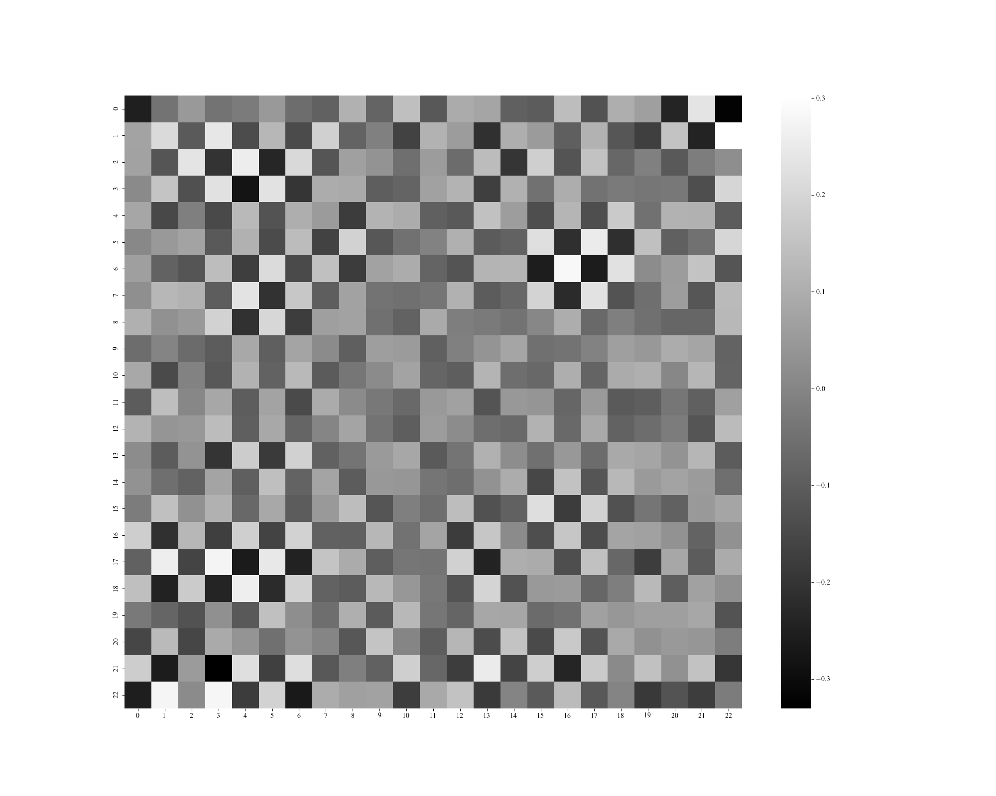
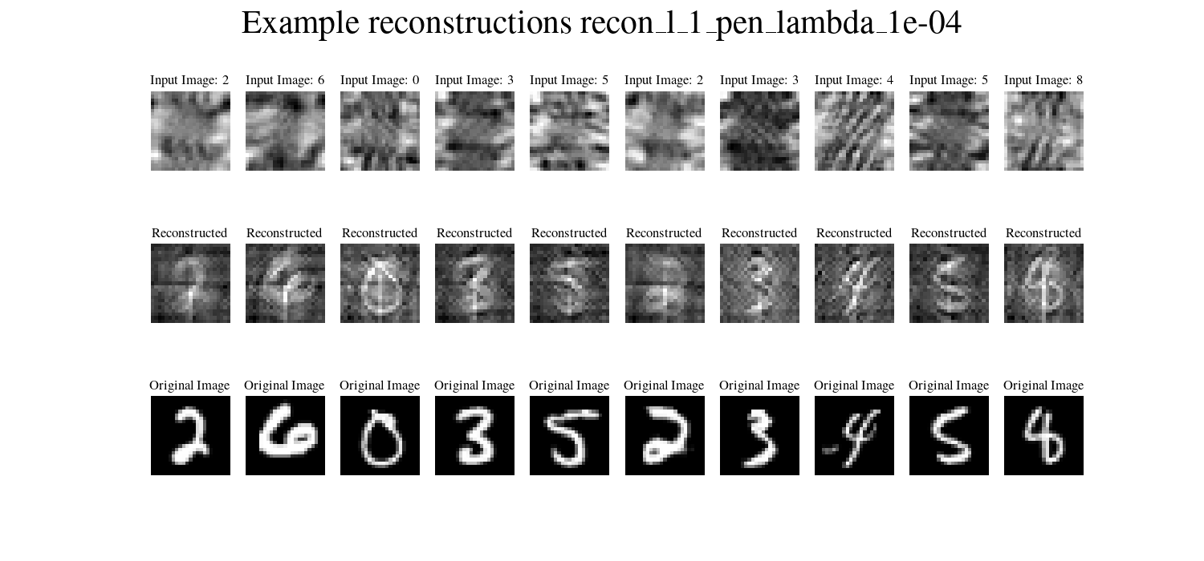
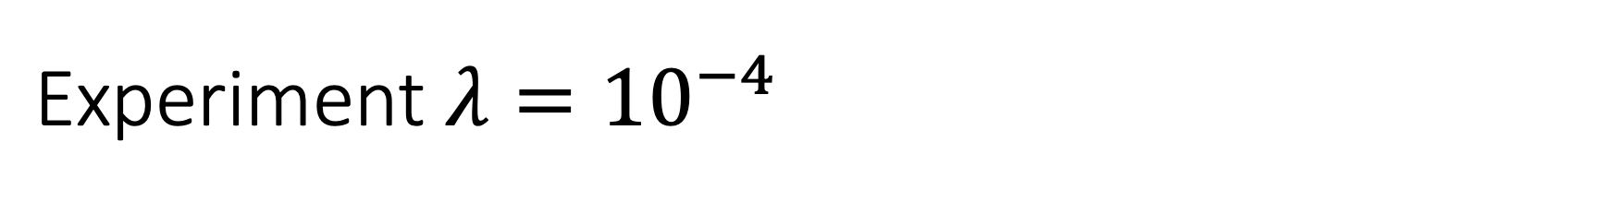
$$\text{Experiment} λ={10}^{−4}$$

Slide 26
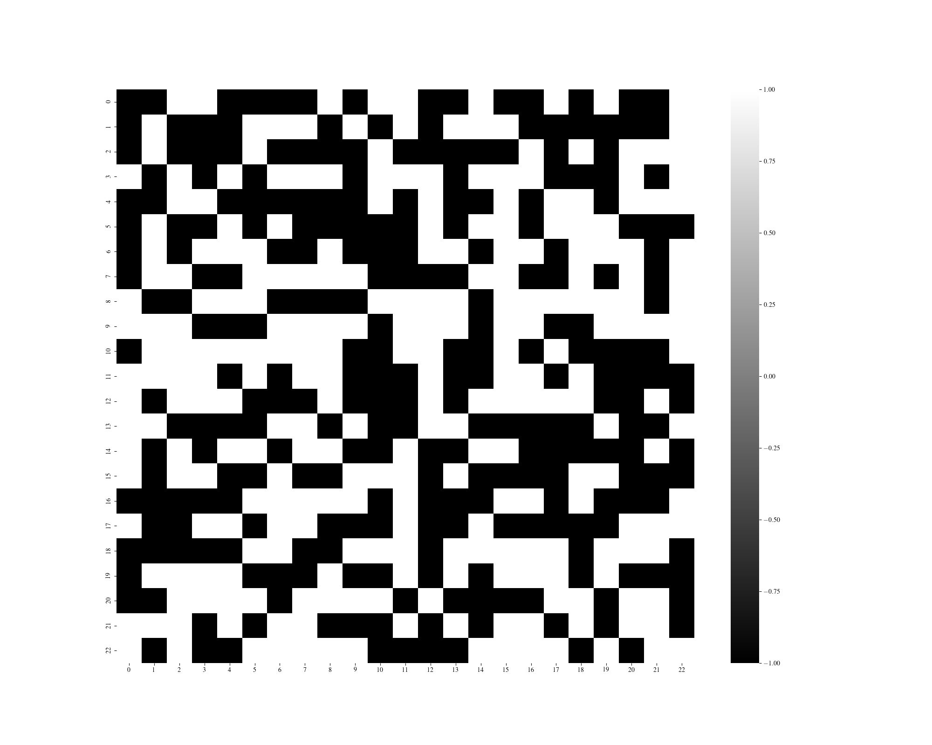
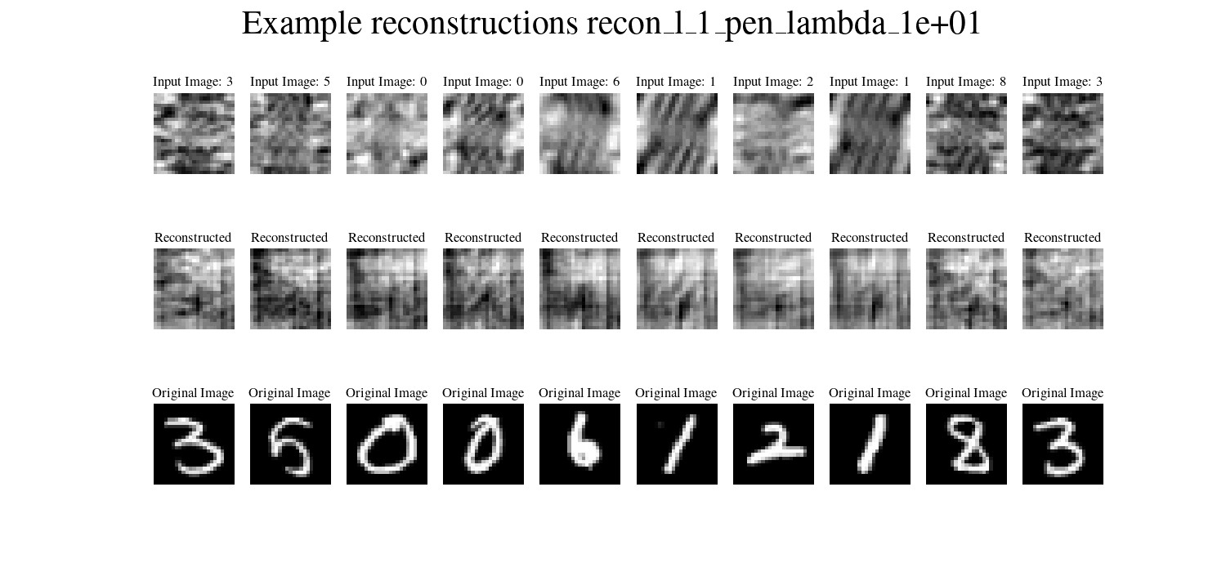
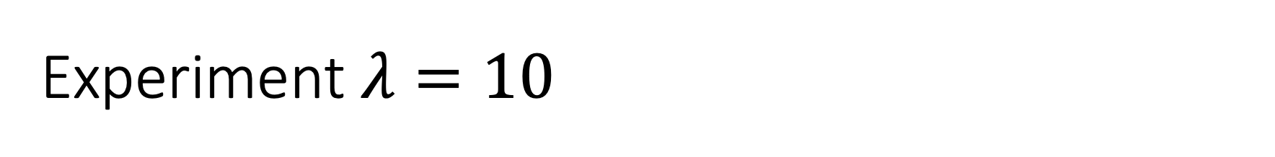
Experiment $λ=10$

Slide 27
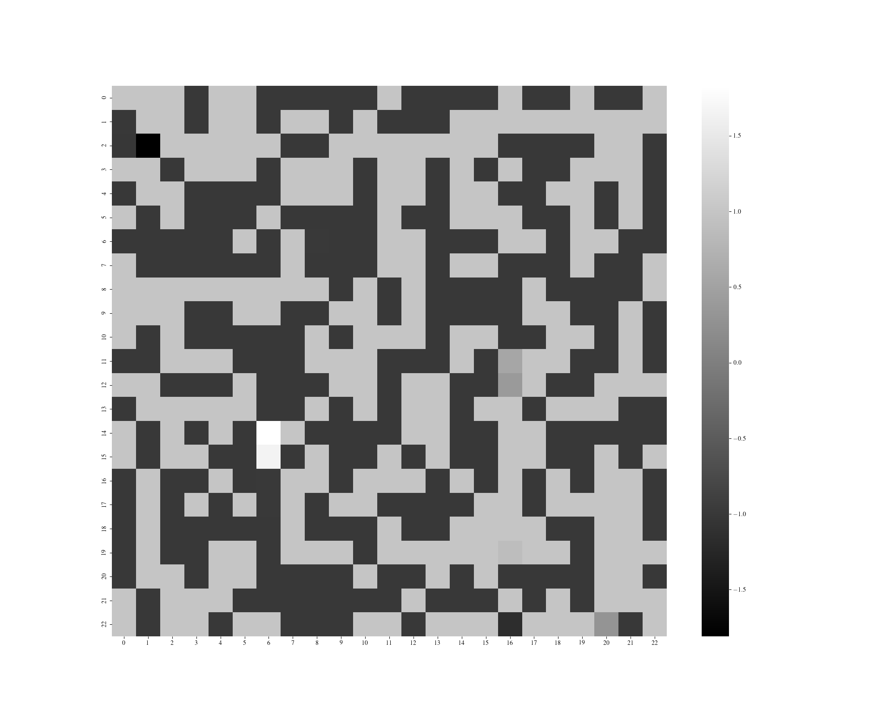
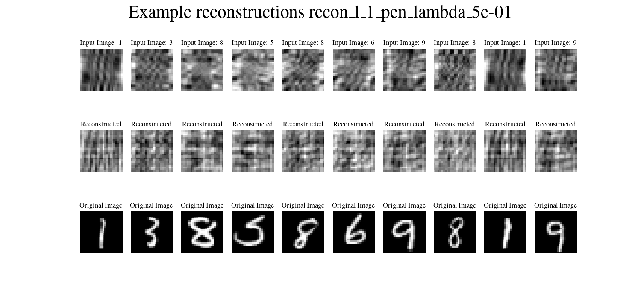
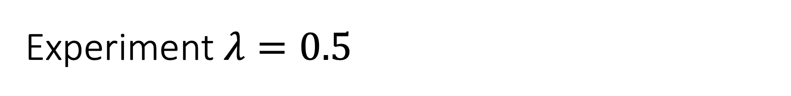
Experiment $λ=0.5$

Slide 28
Tuesday, April 25, 2023
Weekly update

Slide 29
Reconstruction with activation function
NO penalty used

Slide 30
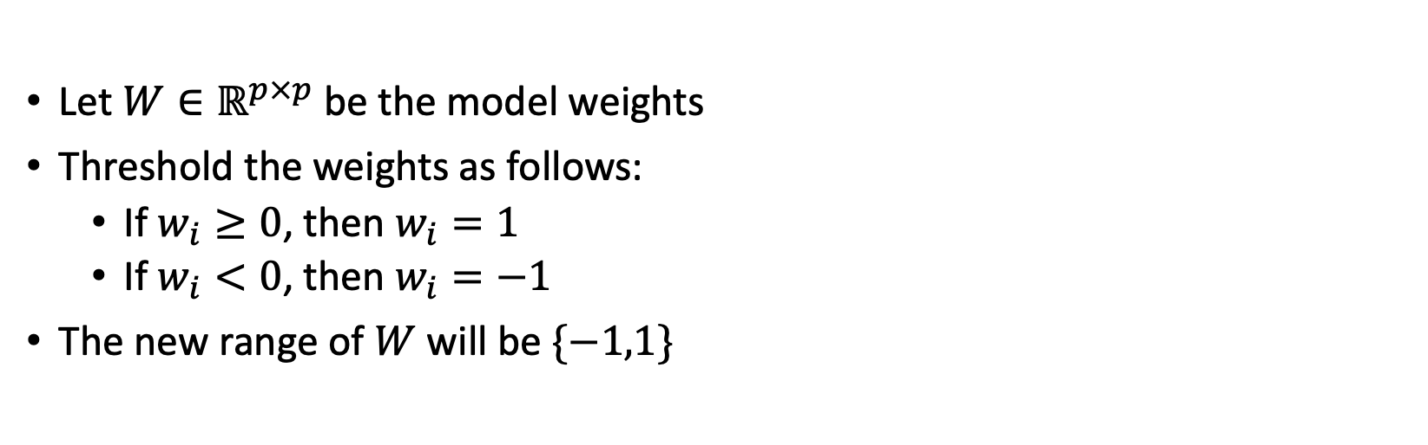
After training, threshold model weights
Let $W∈ℝ^{p×p}$ be the model weights
Threshold the weights as follows:
If $w_{i}≥0$, then $w_{i}=1$
If $w_{i}<0$, then $w_{i}=−1$
The new range of $W$ will be $\{−1,1\}$

Slide 31
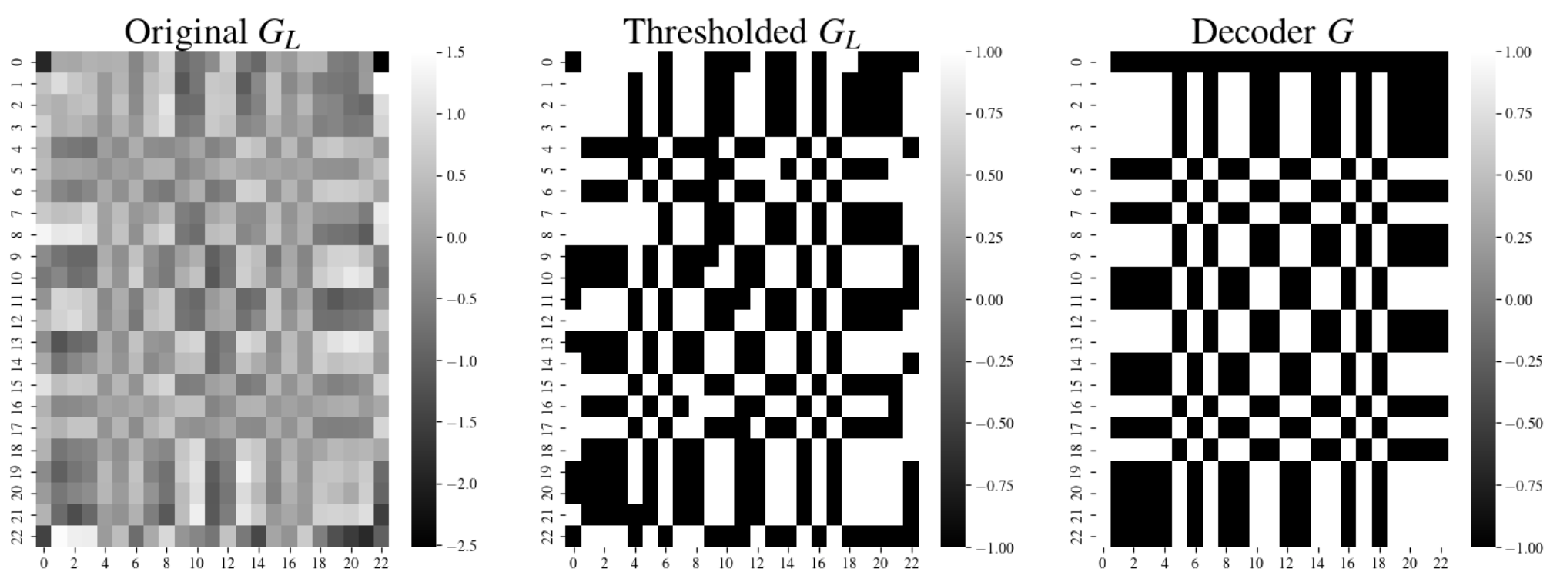
Thresholding results in the weights

Slide 32
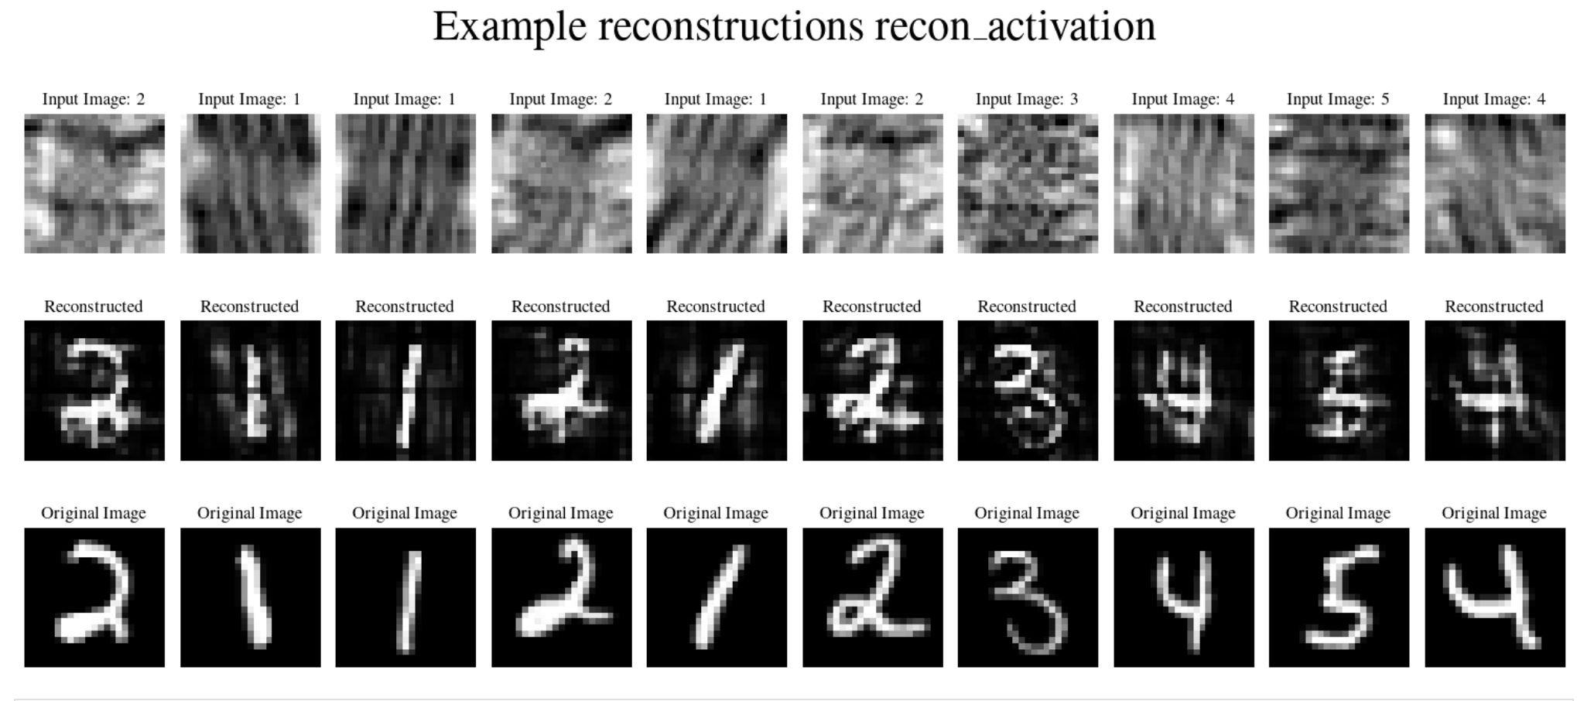
Reconstructions without thresholding
Notes:
Reconstructions stay between [0,1]

Slide 33
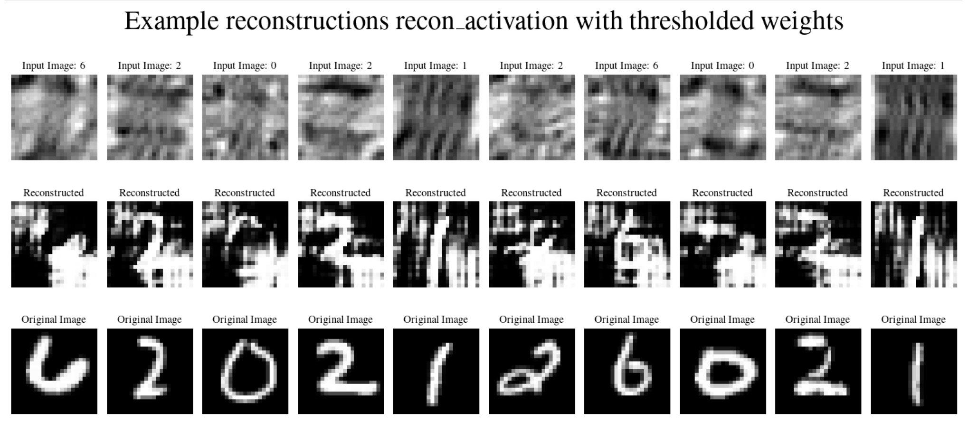
Do the reconstructions improve?

Slide 34
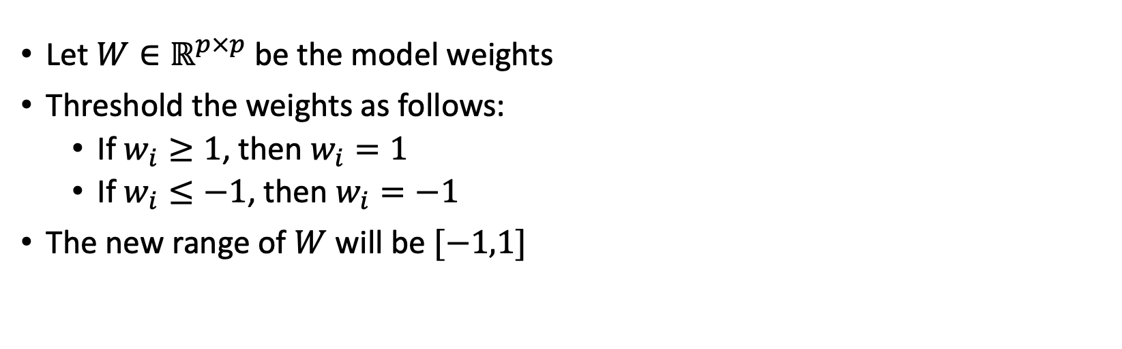
Clipping the weights
Let $W∈ℝ^{p×p}$ be the model weights
Threshold the weights as follows:
If $w_{i}≥1$, then $w_{i}=1$
If $w_{i}≤−1$, then $w_{i}=−1$
The new range of $W$ will be $[−1,1]$

Slide 35

Resulting clipped weights

Slide 36

No improvements if we clip the weights

Slide 37
Quantitative measurements for reconstruction MSE using clipped weights
MSE score for validation set
count 7000.000000
mean 0.248786
std 0.040022
min 0.092891
25% 0.221665
50% 0.249376
75% 0.277356
max 0.398421

Slide 38

Quantitative measurements

Slide 39

Reconstruction with $ℓ_{1}$-penalty

Slide 40


Experiment MAE + sigmoid activation

Slide 41


Experiment MAE (NO activation)
Notes:
Trained for 30 epochs

Slide 42

Incorporating the Mean Absolute Error + penalty
$${Loss}_{MAEpen}= \frac{1}{p^{2}}\sum_{i=1}^{p^{2}}{\left|\tilde{S_{i}}−S_{i}\right|}+ \frac{λ}{p^{2}}\sum_{i=1}^{p^{2}}{\left|\left|w_{i}\right|−1\right|}$$

Slide 43


Experiment $λ=1$

Slide 44



Experiment $λ={10}^{−3}$

Slide 45
Reconstruction with convolution transpose layer
NO penalty and NO activation function

Slide 46

Experiment: Convolutional Transpose + MAE
Replaced 1 convolutional layer with a convolutional transpose layer
MAE loss was used with NO activation function
Did not try convolution transpose with MSE Loss + sigmoid activation

Slide 47
Image classification with noisy images

Slide 48
Experiments
Classify original MNIST images
1
Classify encoded MNIST images
2
Reconstruct encoded MNIST images, then classify from reconstructions
3
CNN with Sigmoid activation
Using noiseless trained model, classify noisy coded images
4

Slide 49
Classification Architecture
2 convolutional layers
2 max pooling layers
4 fully connected layers with ReLu activation
1 output layer

Slide 50







Slide 51
How does the classification model deal with noise?
SNR (dB) | Noiseless Model Accuracy
1 | 87.99
5 | 94.49
10 | 96.41
20 | 96.87
30 | 97.09
I used the classification model trained on noiseless data and applied it to noisy data.
SNR: Signal to Noise Ratio
dB: decibels

Slide 52
Tuesday, May 2, 2023
Weekly update

Slide 53


Example noisy data: updated
Coded observation is given by
$$D=\left(S∗A\right)+B$$
where
$S$ is the original image
$A$ is the aperture
$B$ is Gaussian noise

Slide 54

Method I: Straight Classification
Train↓/Test → | Noiseless | 30dB | 20dB | 10dB | 5dB | 1dB
Noiseless | 97.53 | 97.53 | 97.47 | 96.53 | 93.81 | 82.73
30dB | 97.3 | 97.47 | 97.4 | 96.54 | 91.9 | 76.5
20dB | 97.59 | 97.59 | 97.49 | 96.0 | 86.53 | 65.01
10dB | 97.94 | 97.94 | 97.8 | 97.61 | 95.93 | 88.17
5dB | 97.77 | 97.75 | 97.59 | 97.44 | 96.44 | 91.91
1dB | 96.7 | 96.81 | 96.73 | 96.54 | 95.91 | 93.86

Slide 55


Method II: Reconstruct via traditional methods then classify
Traditional
Method
2
Train↓/Test → | Noiseless | 30dB | 20dB | 10dB | 5dB | 1dB
Noiseless | 99.29 | 99.27 | 99.23 | 98.9 | 97.14 | 88.8
30dB | 99.09 | 99.1 | 99.06 | 94.69 | 80.07 | 60.87
20dB | 99.19 | 99.16 | 99.19 | 99.2 | 98.61 | 93.73
10dB | 99.09 | 99.09 | 95.77 | 99.03 | 98.6 | 95.77
5dB | 99.09 | 99.1 | 99.19 | 99.14 | 98.93 | 97.17
1dB | 98.8 | 98.86 | 98.96 | 98.84 | 98.63 | 97.94

Slide 56

Pixel Value Distribution on a subset of 10,000 images
Original MNIST
Decoded MNIST

Slide 57


T-SNE
7
7
9
4
9
4
2
1
2
8
8
0
1
5
3
0
3
5
6
6

Slide 58


Slide 59
Figures

Slide 60



Brain Disorders
Cancer
Heart Conditions
Brain Disorders
Cancer
Heart Conditions
Alzheimer’s Disease
Parkinson’s Disease
Epilepsy
Kidney cancer
Ovarian cancer
Thyroid cancer
Coronary Artery Disease
Heart Failure

Slide 61




Xray pinhole camera (wip)
X-RAY SOURCE
DECODING PROCEDURE
RECONSTRUCTED IMAGE
X-RAYS
PATIENT
APERTURE
DETECTOR

Slide 62








$$∗$$
$$=$$
Coded aperture $A$
Decoding pattern $G$
$$δ$$

Slide 63



Aperture
Observation
Signal

Slide 64


Aperture
Observation
Signal

Slide 65


Aperture
Observation
Signal

Slide 66



$$∗$$
$$∗$$
$$=$$

Slide 67
$$∗$$
$$∗$$
$$=$$
Coded observation

Slide 68





$$∗$$
$$=$$
$$S$$
$$A$$
$$D$$

Slide 69




Signal
Aperture
Observation
Reconstruction
$$S$$
$$A$$
$$D$$
$$\hat{S}$$

Slide 70
2
X-RAY SOURCE
X-RAYS
SOURCE
APERTURE
OBSERVATION
DECODING PROCEDURE
CLASSIFICATION

Slide 71
2
X-RAY SOURCE
X-RAYS
SOURCE
APERTURE
OBSERVATION
DECODING PROCEDURE
CLASSIFICATION

Slide 72
conv
2
convolutional + sigmoid
1 x 23 x 23

Slide 73



2
=
*
Class Label
Encoded Image
$$D$$
Decoder
$$G$$
Reconstructed Image
$$\hat{S}$$

Slide 74

2
Class Label
Encoded Image
$$D$$

Slide 75


Slide 76
Traditional Reconstruction Method
2

Slide 77


Slide 78



True image
Observation

Slide 79









Slide 80











Misclassifications from original MNIST

Slide 82
Input
2
1 x 23 x 23

Slide 83



